Slide 1

#ᴅʟᴘ_MICRODOT [{'title': 'Data Security Classification', 'text': 'Confidential'}, {'title': 'doc_id', 'text': '1jy52UoPeZtsW1kCJqLhVbx7bc5qMum0AQTHbKRCyisY'}]_END
IntelliJ Plugins: Build Simple Plugins to Streamline Your Workflow
Thomas Belk
Notes:
Hello all, welcome to my talk about IntelliJ Plugins and how you can build simple IDE Plugins to streamline your workflow!

Slide 2


#ᴅʟᴘ_MICRODOT [{'title': 'Data Security Classification', 'text': 'Confidential'}, {'title': 'doc_id', 'text': '1w07PRSagQppNSJ-d2Upzal5uI3O6sxGEP_PpN3unxpw'}]_END
IntelliJ Plugins: Build Simple Plugins to Streamline Your Workflow
(Tom) Belk
Notes:
My name is Tom, not Thomas, and I work for Capital One as one of our Android Platform engineering leads. I’ve been doing Android development since 2010 when Eclipse was still our main IDE and Android Cupcake had just been released.

Slide 3

#ᴅʟᴘ_MICRODOT [{'title': 'Data Security Classification', 'text': 'Confidential'}, {'title': 'doc_id', 'text': '12JUmWeewr_0-FSgFp6q-ePuR78R652-tUpR5pDG63Us'}]_END
When you hire more engineers but your output stays the same and now you have more engineers
Notes:
How many of you have seen this happen? You hire more engineers but your output stays the same…and now you have more engineers!

Slide 4
#ᴅʟᴘ_MICRODOT [{'title': 'Data Security Classification', 'text': 'Confidential'}, {'title': 'doc_id', 'text': '12JUmWeewr_0-FSgFp6q-ePuR78R652-tUpR5pDG63Us'}]_END
Superior developer experience (DevEx) translates to higher productivity, improved app quality, greater facility for innovation, and happier engineers
Notes:
I believe a seamless and intuitive developer experience is a critical driver of success. For Android engineers, superior DevEx translates into higher productivity, improved application quality, greater capacity for innovation, and happier engineers.

Slide 5
#ᴅʟᴘ_MICRODOT [{'title': 'Data Security Classification', 'text': 'Confidential'}, {'title': 'doc_id', 'text': '12JUmWeewr_0-FSgFp6q-ePuR78R652-tUpR5pDG63Us'}]_END
DevEx is not prioritized enough. Areas like onboarding, context switching, automatable actions and support need more attention.
Notes:
In my opinion DevEx is not prioritized enough. Areas like onboarding, context switching, automatable actions and support need more attention.
Onboarding is usually broken down into a few steps with some companies going so far as to measure time to first commit.
Context Switching between writing code and being outside of the codebase has a variable hit to engineering throughput.
CLI Interactions with build tools like Gradle are one of the primary ways to validate changes. However in large codebases there could be a potential for better abstractions of some of these tasks.
And Support of our larger engineering community breaks down into BAU or run the engine tasks such as 3rd party library upgrades, language support, bugs, prod issues, documentation, and direct/indirect forms of communication like Slack & email

Slide 6

#ᴅʟᴘ_MICRODOT [{'title': 'Data Security Classification', 'text': 'Confidential'}, {'title': 'doc_id', 'text': '12JUmWeewr_0-FSgFp6q-ePuR78R652-tUpR5pDG63Us'}]_END
What can you do about it?
Notes:
So what can you do about it?

Slide 7
#ᴅʟᴘ_MICRODOT [{'title': 'Data Security Classification', 'text': 'Confidential'}, {'title': 'doc_id', 'text': '12JUmWeewr_0-FSgFp6q-ePuR78R652-tUpR5pDG63Us'}]_END
Create an IDE Plugin!
Notes:
Why not create an IDE Plugin?!!!

Slide 8
#ᴅʟᴘ_MICRODOT [{'title': 'Data Security Classification', 'text': 'Confidential'}, {'title': 'doc_id', 'text': '12JUmWeewr_0-FSgFp6q-ePuR78R652-tUpR5pDG63Us'}]_END
IntelliJ IDE Plugins
Built leveraging the IntelliJ Platform SDK
Primarily written using Java/Kotlin, Swing/Compose, and Gradle
Many existing features are implemented as plugins
Examples: Android Design Tools, Plugin DevKit
Capabilities range from...
- simple menu items
- language support
- build systems
- debuggers
- UI previews
Alternatives:
- Structural Search and Replace
- IDE Scripting Console
- Flora Plugin (beta)
Notes:
Source (main page)
The IntelliJ Platform SDK provides a platform for building IDEs, such as Android Studio from Google. It is used to power JetBrains products and is Open Source.
Plugins are primarily written using Java & Kotlin, Swing & Compose, and Gradle. There are many existing Plugins that some you may already know like the Android Design Tools and the Plugin DevKit.
Plugins can range in complexity from simple menu items to supporting entire languages.
In some cases, implementing an actual IntelliJ Platform plugin can be overkill. Alternatives exist such as:
Structural Search and Replace
[Optional] let you search for a particular code pattern or grammatical construct in your code considering your code structure. You leverage templates to find and update code
IDE Scripting Console
[Optional] can be used to write simple scripts that automate IntelliJ IDEA features and extract various information. Scripts can access the IntelliJ Platform APIs and can be implemented in Kotlin, JavaScript, or Groovy
Flora Plugin
[Optional] allows for developing project-specific extensions as Kotlin Script (*.kts) or JavaScript (*.js) files. Flora extensions have access to all available IntelliJ Platform APIs, just like a regular plugin.

Slide 9

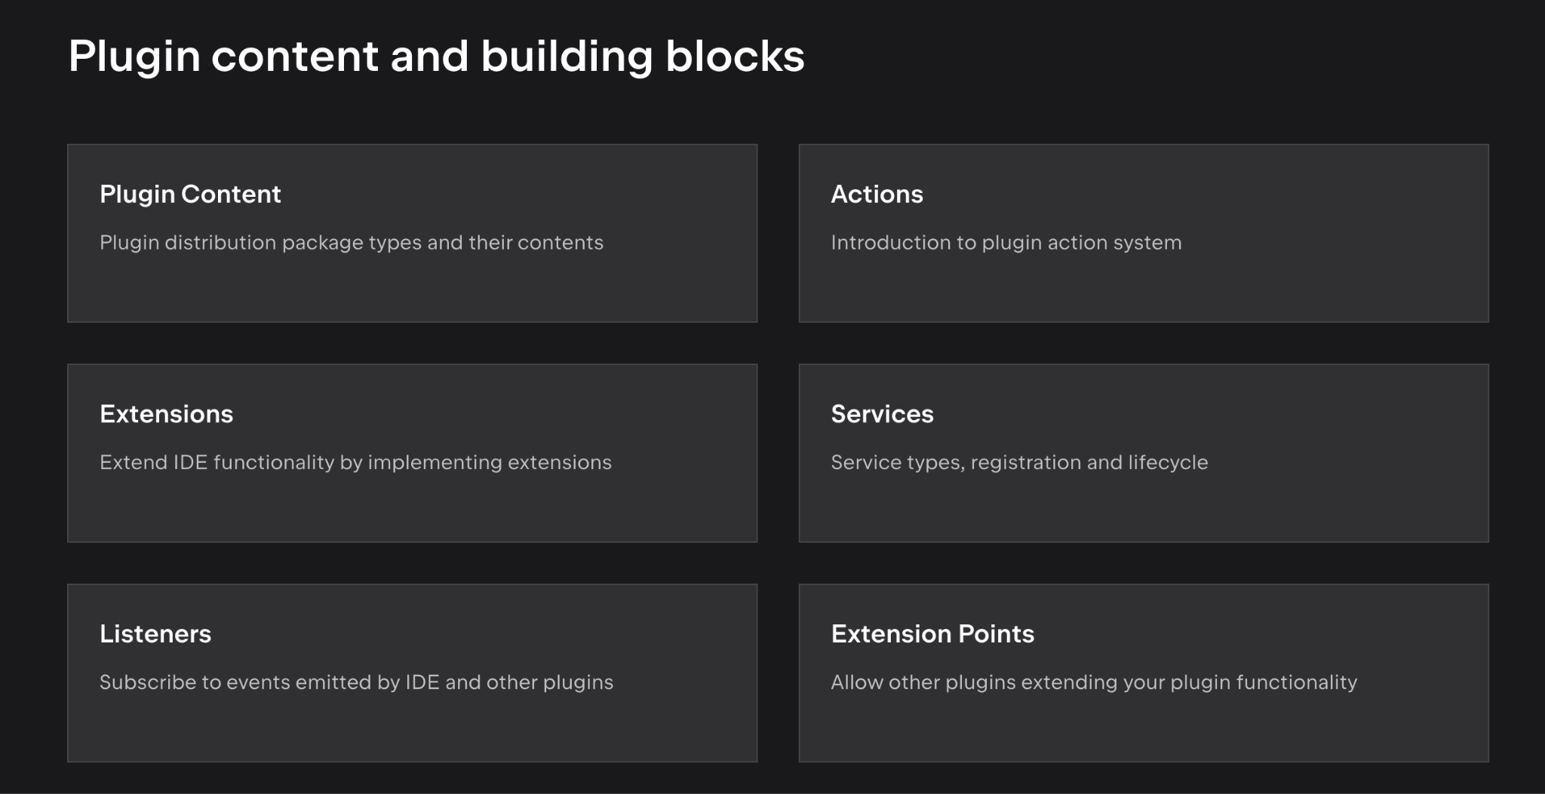
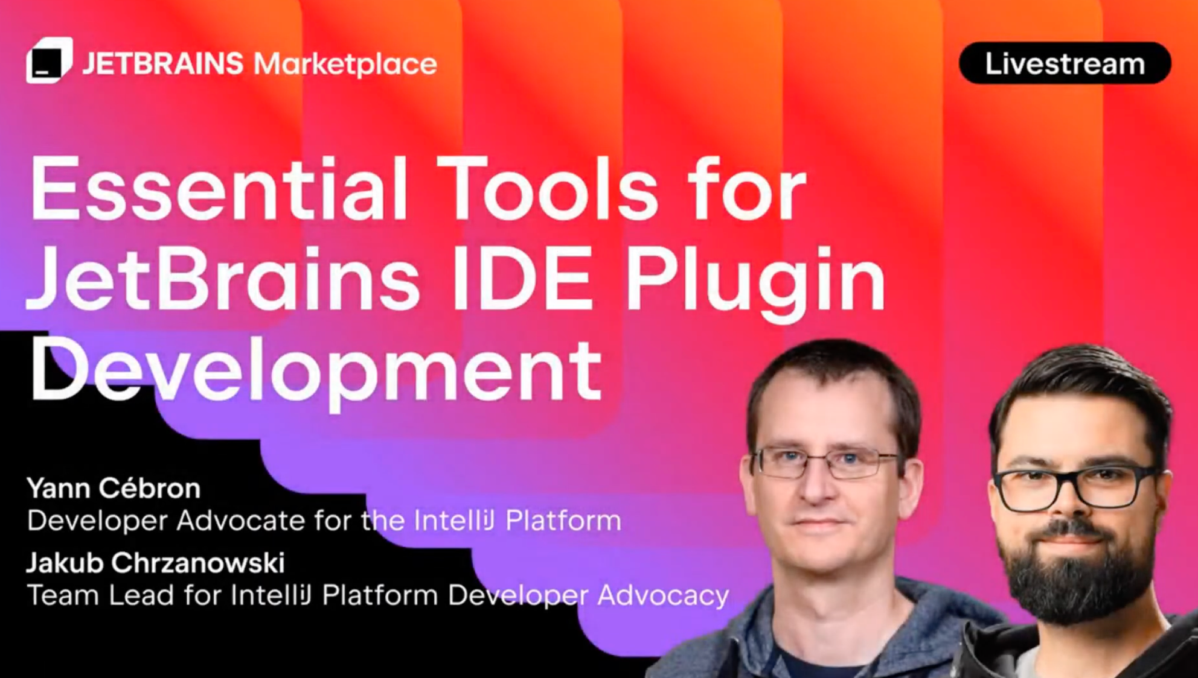
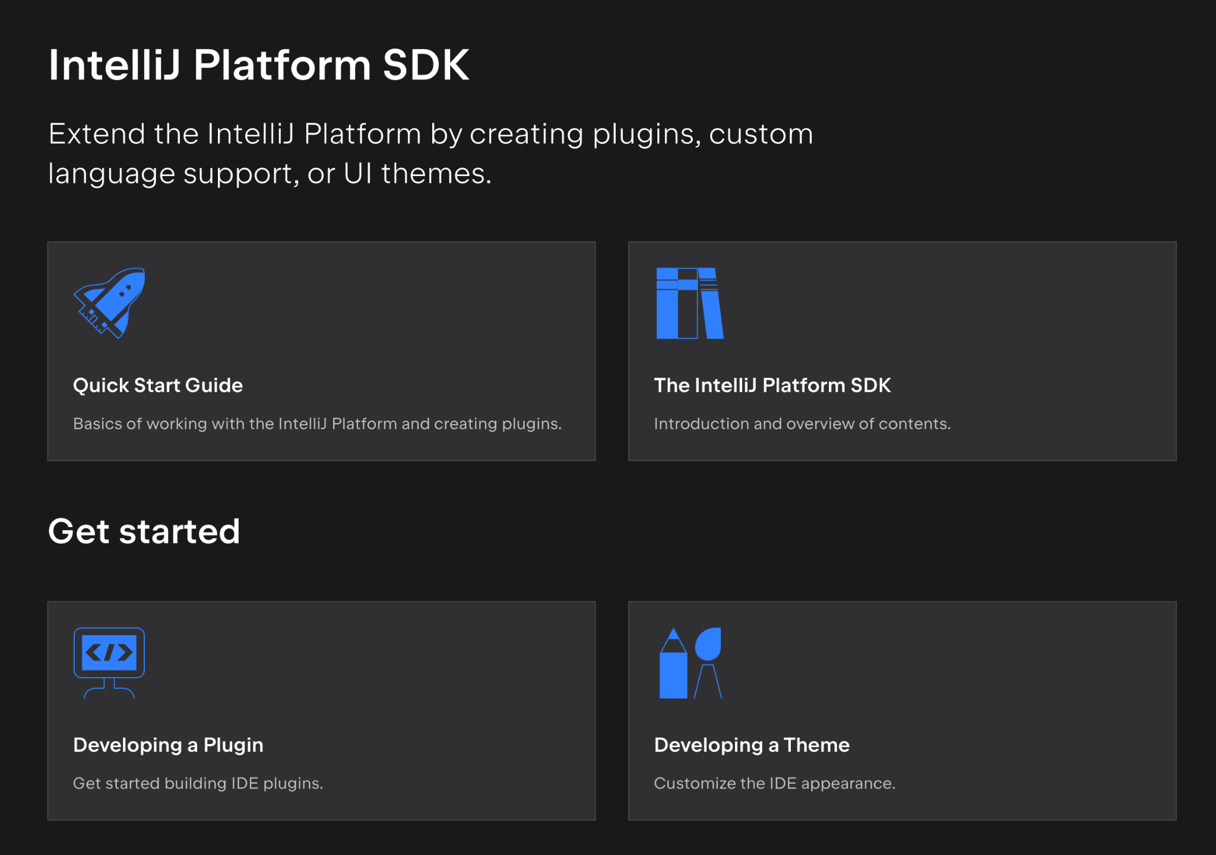
#ᴅʟᴘ_MICRODOT [{'title': 'Data Security Classification', 'text': 'Confidential'}, {'title': 'doc_id', 'text': '12JUmWeewr_0-FSgFp6q-ePuR78R652-tUpR5pDG63Us'}]_END
Learn about IntelliJ IDE Plugins from the best
Plugin Developer Conf
Essential Tools for JetBrains IDE Plugin Development
Plugin content and building blocks
IntelliJ Platform SDK
Notes:
I am far from any authority or expert on IDE Plugins so I would recommend learning more about them from the best.
Jetbrains held their first Plugin Developer Conference back in Nov of 2024 with nearly 7 hours of content! I’m not going to best that today.

Slide 10
#ᴅʟᴘ_MICRODOT [{'title': 'Data Security Classification', 'text': 'Confidential'}, {'title': 'doc_id', 'text': '12JUmWeewr_0-FSgFp6q-ePuR78R652-tUpR5pDG63Us'}]_END
What are our goals?
- Improve the Developer Experience
- Personalize development environments
- Standardize best practices
- Decrease context switching
- Shorten feedback loops
- Better support & troubleshooting
Notes:
So what are our goals when creating an IDE Plugin?
We want to improve DevEx
Provide the ability to personalize dev environments
Standardize and more importantly codify best practices
Decrease context switching
Provide shorter feedback loops
And streamline support and troubleshooting

Slide 11


#ᴅʟᴘ_MICRODOT [{'title': 'Data Security Classification', 'text': 'Confidential'}, {'title': 'doc_id', 'text': '12JUmWeewr_0-FSgFp6q-ePuR78R652-tUpR5pDG63Us'}]_END
Working Code Samples w/SimpleJ
Open Source project
Available in the Marketplace or install via its artifact.zip
Meant to be a teaching tool, inspire ideas, and be forked
Should not be viewed as a utility in and of itself
Do you like it’s logo? Gemini helped...
Notes:
To provide a teaching aid that compliments this presentation I created an open source project called SimpleJ.
I want to emphasize that it’s meant as teaching tool, to inspire ideas for better DevEx, and provide code examples and recipes.
The project and it’s IDE Plugin are not meant to be used as a literal utility or something that should or will snowball into a larger DevEx IDE project.
Do you like it’s logo? :) Gemini helped a bit so blame it for the extreme accuracy.

Slide 12
#ᴅʟᴘ_MICRODOT [{'title': 'Data Security Classification', 'text': 'Confidential'}, {'title': 'doc_id', 'text': '12JUmWeewr_0-FSgFp6q-ePuR78R652-tUpR5pDG63Us'}]_END
Working Code Sample w/SimpleJ
Open Source project
Available in the Marketplace or install via its artifact.zip
Meant to be a teaching tool, inspire ideas, and be forked
Should not be viewed as a utility in and of itself
Do you like it’s logo? Gemini helped...
Note: This project was not created using the IntelliJ Plugin Template
Notes:
Please note, this project was not created using the IntelliJ Plugin Template. I sought to start the project from scratch, adding only what I needed, when I need it.

Slide 13
#ᴅʟᴘ_MICRODOT [{'title': 'Data Security Classification', 'text': 'Confidential'}, {'title': 'doc_id', 'text': '12JUmWeewr_0-FSgFp6q-ePuR78R652-tUpR5pDG63Us'}]_END
Working Code Sample w/SimpleJ
Open Source project
Available in the Marketplace or install via its artifact.zip
Meant to be a teaching tool, inspire ideas, and be forked
Should not be viewed as a utility in and of itself
Do you like it’s logo? Gemini helped...
Note: This project is not perfect...please go easy
Notes:
Please also note, the project is far from perfect so please go easy.
Matter of fact I was fixing some edge cases last night. Unfortunately I am unable to publish a new Plugin version as my private signing keys and upload token are on another laptop. I brought two laptops here and of course they’re on the third.

Slide 14
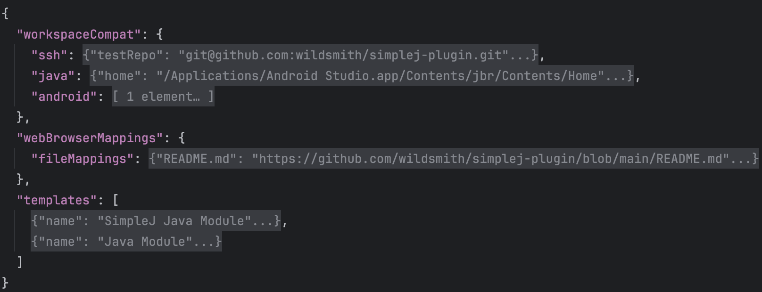
#ᴅʟᴘ_MICRODOT [{'title': 'Data Security Classification', 'text': 'Confidential'}, {'title': 'doc_id', 'text': '12JUmWeewr_0-FSgFp6q-ePuR78R652-tUpR5pDG63Us'}]_END
SimpleJ Config
config > simplej > simplej-config.json
Configuration file that informs various SimpleJ attributes, including:
- New module templates
- Web Browser overlay mappings
- Workspace validation checks...
- ssh
- java version/home
- android build tools
Notes:
SimpleJ consumes a json file that informs various Actions:
New module templates
Browser overlay mappings
And, workspace validation checks
More on those in a second
This file is one way to customize what the IDE Plugin offers in a sharable file that can be pushed into your codebase.

Slide 15
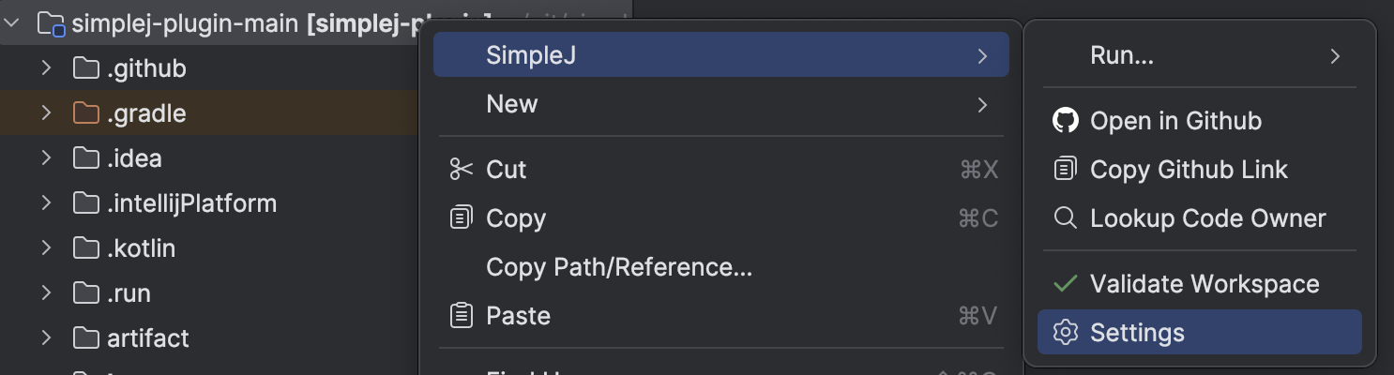
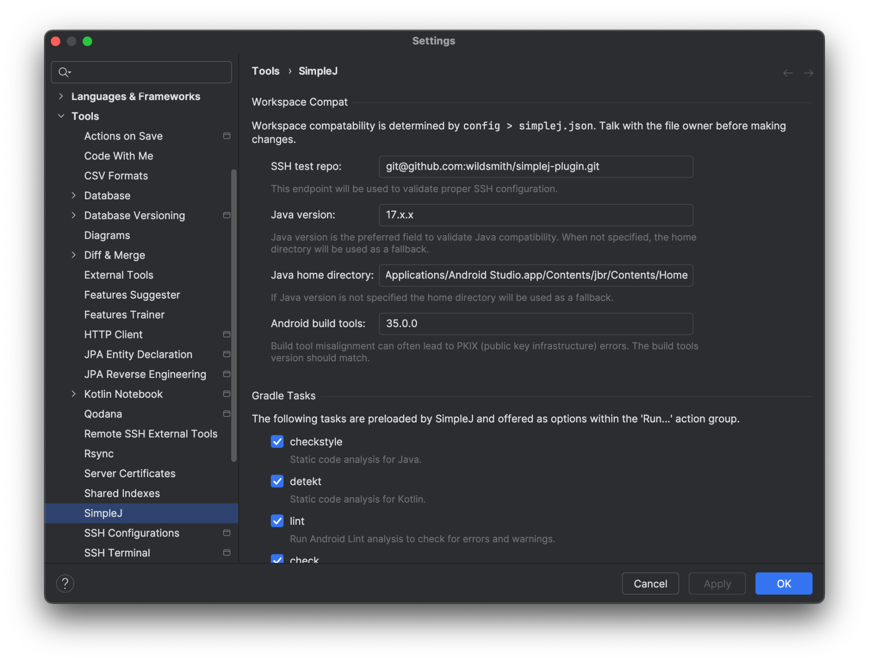
#ᴅʟᴘ_MICRODOT [{'title': 'Data Security Classification', 'text': 'Confidential'}, {'title': 'doc_id', 'text': '12JUmWeewr_0-FSgFp6q-ePuR78R652-tUpR5pDG63Us'}]_END
SimpleJ Settings
Easily accessible through SimpleJ’s Popup Menu Actions
Customized by simplej-config.json
Allows for storing plugin State changes
Provides a visual surface for simplej-config.json
Notes:
The Plugin offers Settings that are both populated by the config json file as well as offer users the ability to customize their instance of the IDE Plugin. Where the json file is a global configuration, the ability to customize the Plugin in settings is localized to the current machine.

Slide 16
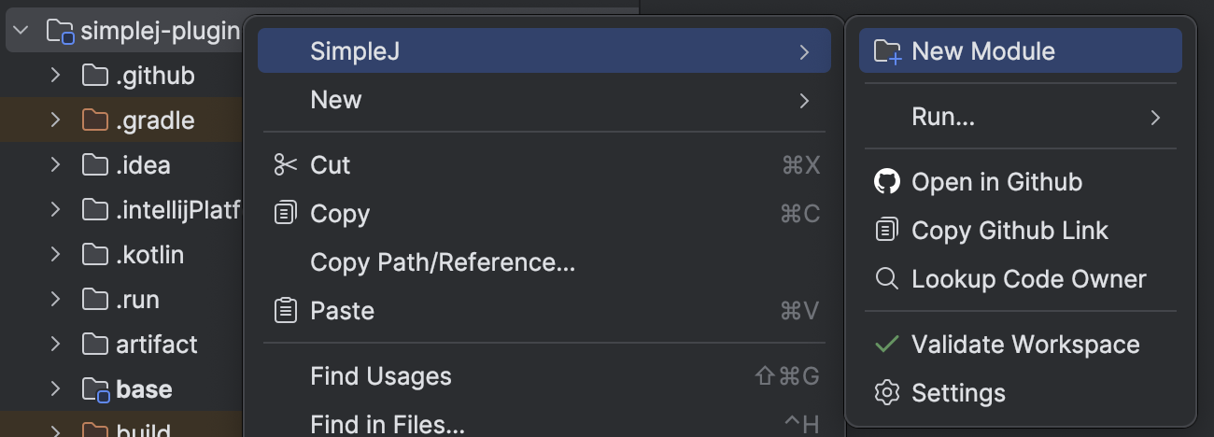
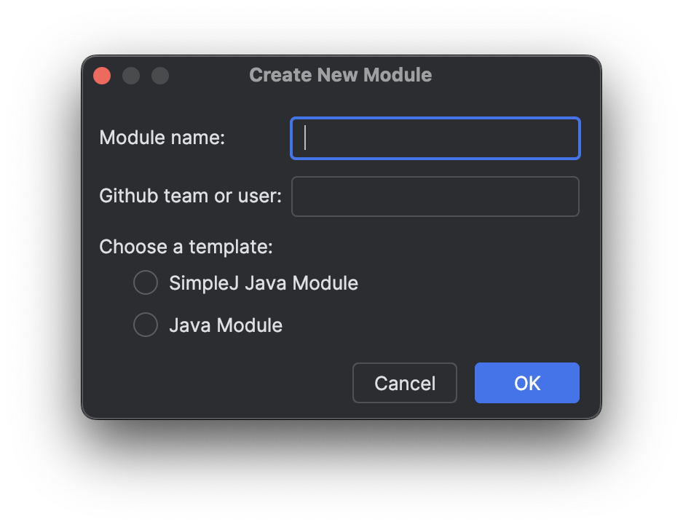
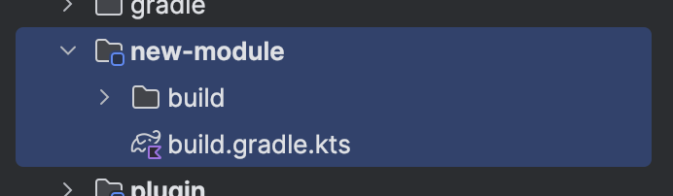
#ᴅʟᴘ_MICRODOT [{'title': 'Data Security Classification', 'text': 'Confidential'}, {'title': 'doc_id', 'text': '12JUmWeewr_0-FSgFp6q-ePuR78R652-tUpR5pDG63Us'}]_END
New Module Creation
Without SimpleJ
With SimpleJ
Right click > SimpleJ > New Module
Utilize Intellij/Android Studio new module templates
Fill in gaps for additional metadata; CODEOWNERS
Update prefabbed files for project specific capabilities; convention plugin’s, DSL configuration, etc
Manually Gradle Sync
CODEOWNERS
settings.gradle.kts
Gradle sync
Notes:
When it comes to new module creation…
Prior to SimpleJ engineers would:
Utilize IntelliJ or Android Studio’s new module templates
Fill in the gaps for additional metadata like CODEOWNERS
Update the prefabbed files for project specific capabilities, such as convention plugin’s, DSL usage in the build file, feature architecture scaffolding and more
Delete any unnecessary prefabbed files
And finally kick off a Gradle Sync or two after making updates to the new module
With SimpleJ engineers only need to:
Right click on the directory they wish to add a new module within
Click New Module
Fill in a few details like module name, codeowner Github team or user name, and their template of choice
SimpleJ will leverage the template’s defined within it’s config json file, update CODEOWNERS, settings.gradle.kts, and trigger a Gradle Sync

Slide 17
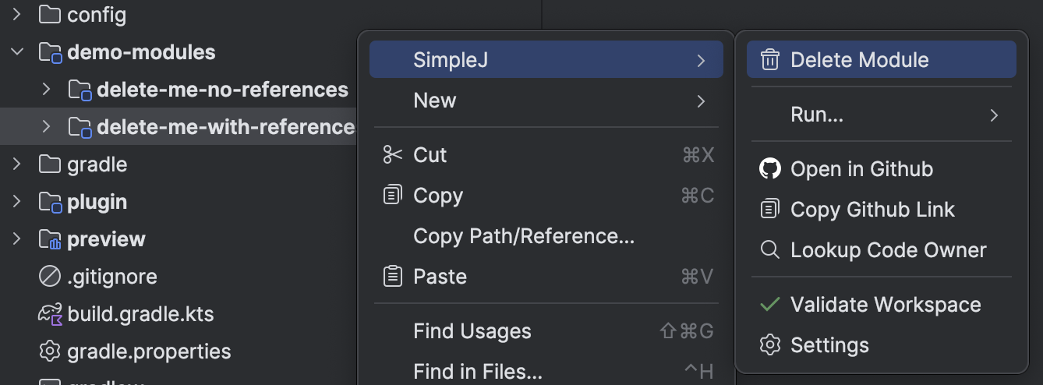
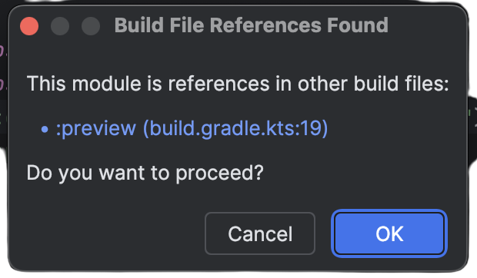
#ᴅʟᴘ_MICRODOT [{'title': 'Data Security Classification', 'text': 'Confidential'}, {'title': 'doc_id', 'text': '12JUmWeewr_0-FSgFp6q-ePuR78R652-tUpR5pDG63Us'}]_END
Module Deletion
Without SimpleJ
With SimpleJ
Right click > SimpleJ > Delete Module
Delete the module’s directory
Manually delete references to the module from disparate locations; CODEOWNERS, settings.gradle.kts, .gitignore
Ensure no dependencies exist on the project
Notes:
When it comes to module deletion…
Prior to SimpleJ engineers would:
Manually delete references to the module from disparate locations such as CODEOWNERS and settings.gradle.kts
Default deletion within Android Studio can be problematic and miss references to the module within build files
With SimpleJ engineers only need to:
Right click on the module they wish to delete
Click delete module
And, if references to the module are found within another’s build file a conditional dialog will appear asking users if they wish to proceed

Slide 18
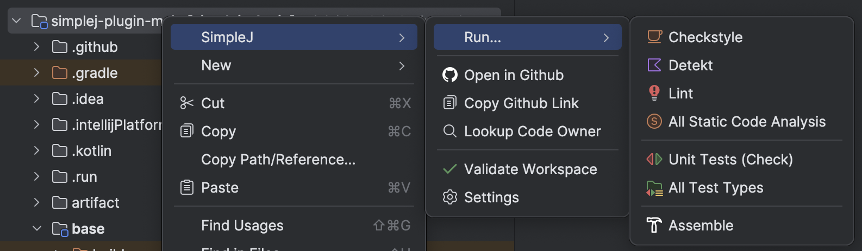
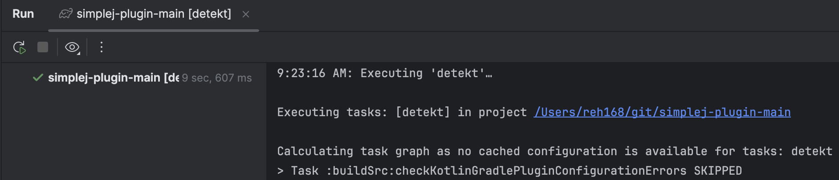
#ᴅʟᴘ_MICRODOT [{'title': 'Data Security Classification', 'text': 'Confidential'}, {'title': 'doc_id', 'text': '12JUmWeewr_0-FSgFp6q-ePuR78R652-tUpR5pDG63Us'}]_END
Gradle Task Execution
Without SimpleJ
With SimpleJ
Right click > SimpleJ > Run... > ...
Within terminal navigate to the appropriate project directory
Concat lengthy Gradle paths together for task execution
Remember arbitrary task options & properties
Notes:
When it comes to executing Gradle tasks…
Prior to SimpleJ engineers would:
Manually navigate to the module or directory they’d like to run Gradle tasks within OR trigger the Gradle tasks vai the Gradle task panel within the IDE.
If they were using the terminal there was also the potential for concating lengthy Gradle paths together for task execution
And finally engineers would have to remember arbitrary task options or properties whenever running specific commands
With SimpleJ engineers only need to:
Right click on the module, directory, or file within the module they wish to run a Task within.
Click the Task or Task cluster they want to execute
SimpleJ will find the closest module or modules to execute said task.
By default, SimpleJ offers a few preloaded Task Actions which can be toggled on/off through settings

Slide 19
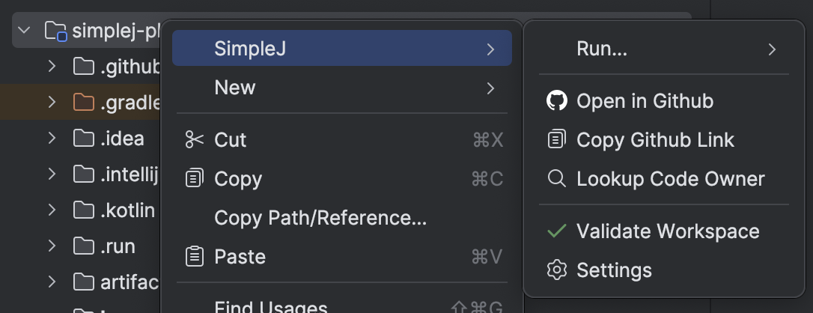
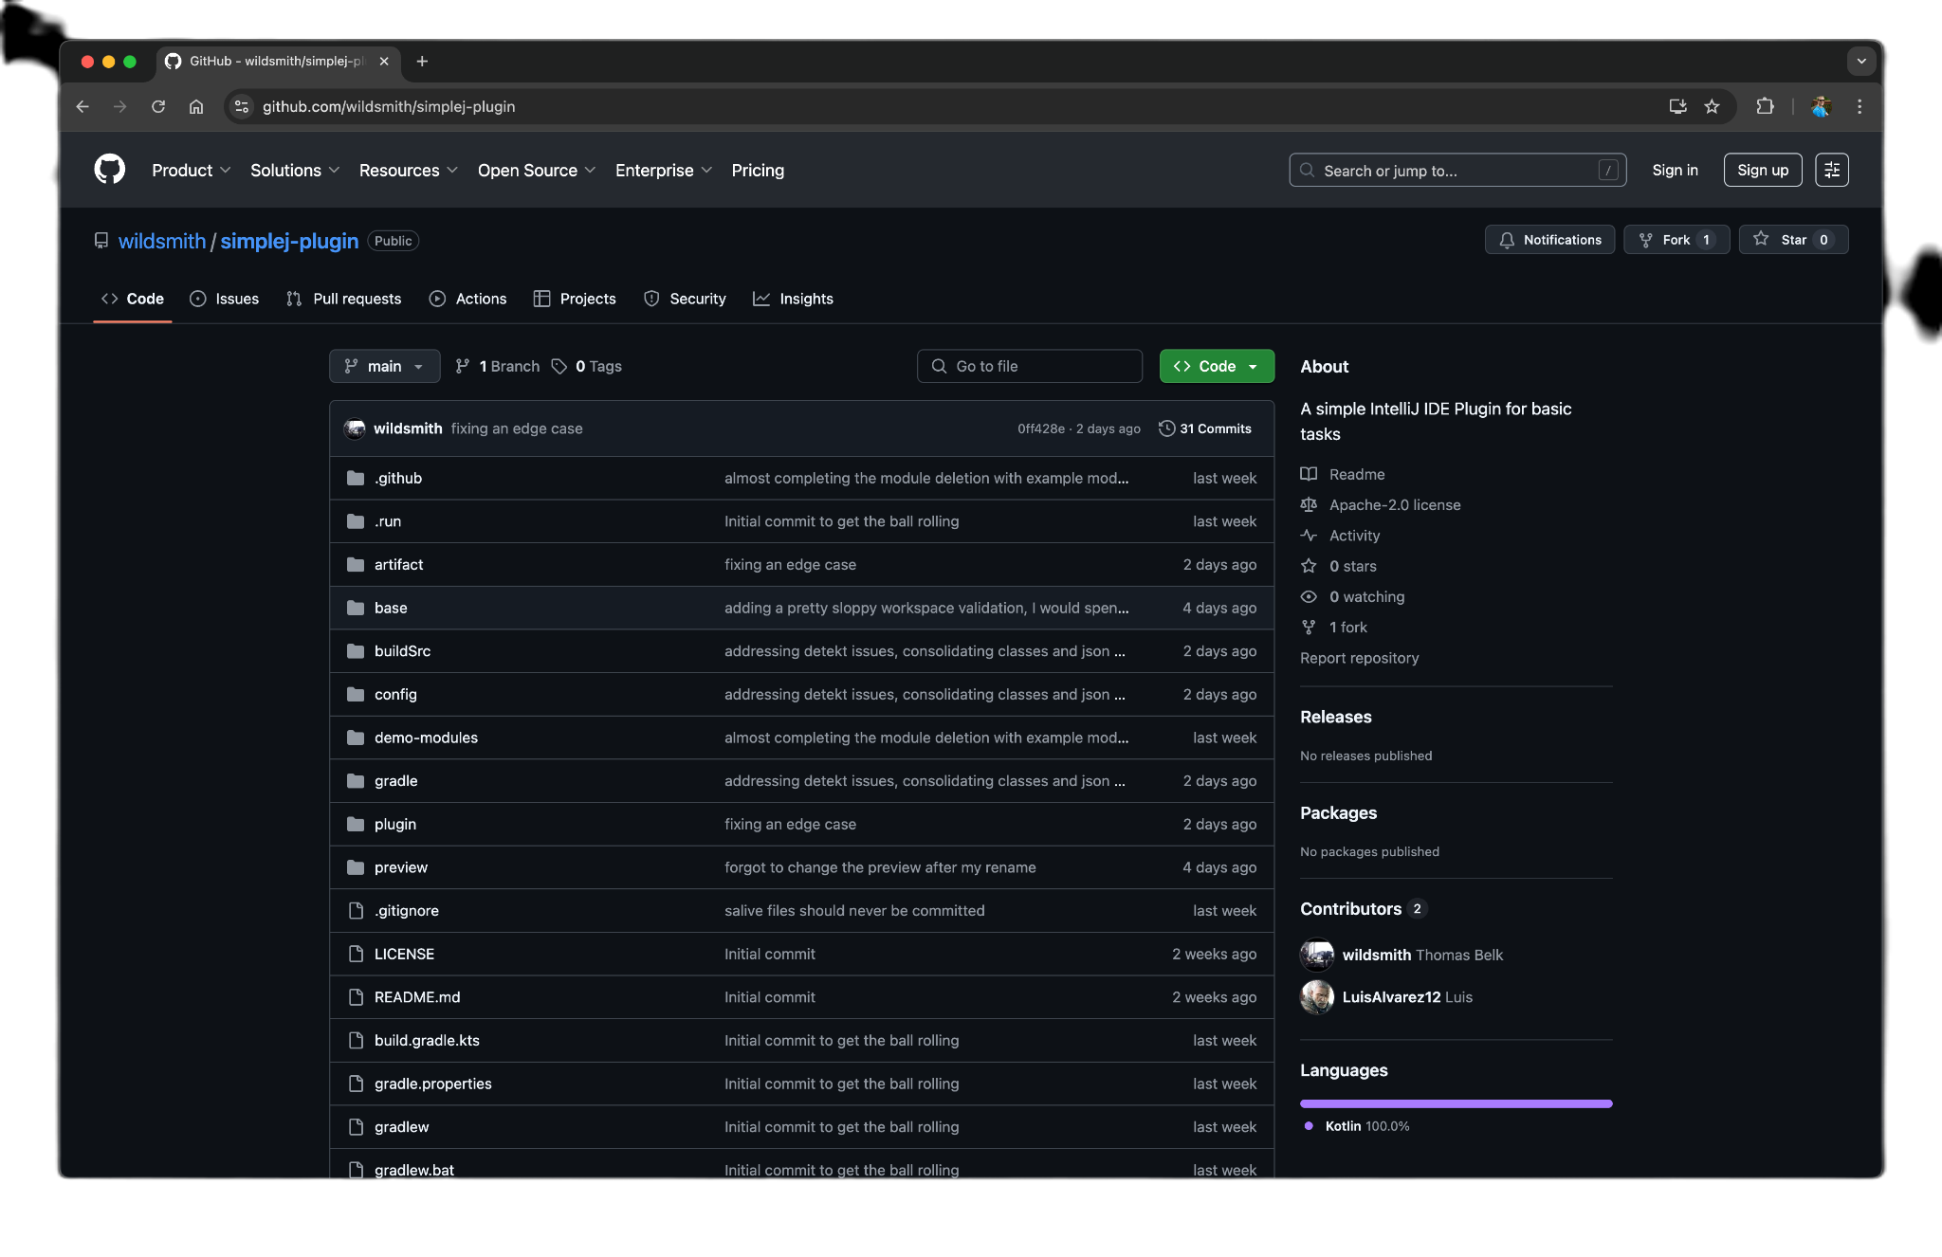
#ᴅʟᴘ_MICRODOT [{'title': 'Data Security Classification', 'text': 'Confidential'}, {'title': 'doc_id', 'text': '12JUmWeewr_0-FSgFp6q-ePuR78R652-tUpR5pDG63Us'}]_END
Open in Github/Copy Github Link
Without SimpleJ
With SimpleJ
Right click > SimpleJ > Open in Github
Identify a file’s repository and branch
Open a browser tab and manually navigate the repository
When sharing code, manually copy the tab’s url
Specific line navigation requires additional steps
Notes:
Note, prior to creating the Open in Github Action I wasn’t aware that it already existed, within IntelliJ Ultimate at least. It’s not there for Android Studio. I happened to stumble upon. I think there are two takeaways from that:
There are a ton of helpful Actions that already exist, check to see if the one you’d like to build isn’t already available.
The discoverability of Actions could be improved. Even when searching for ‘Open in Github’, ‘Open’, or ‘Github’, none of the results were the open Action for Github
Anyway…
Prior to SimpleJ engineers would:
Need to identify a file’s repository manually
Open the browser tab, then manually navigate to the repository
Determine which branch they’d like to view the code within
Manually copy and share out the url
With SimpleJ engineers only need to:
Right click on any tracked module, directory or file
Click ‘Open in Github’ which will automatically launch their preferred browser with a new tab for to Github
Or, click the ‘Copy Github Link’ to just copy the url for even faster sharing with teammates

Slide 20
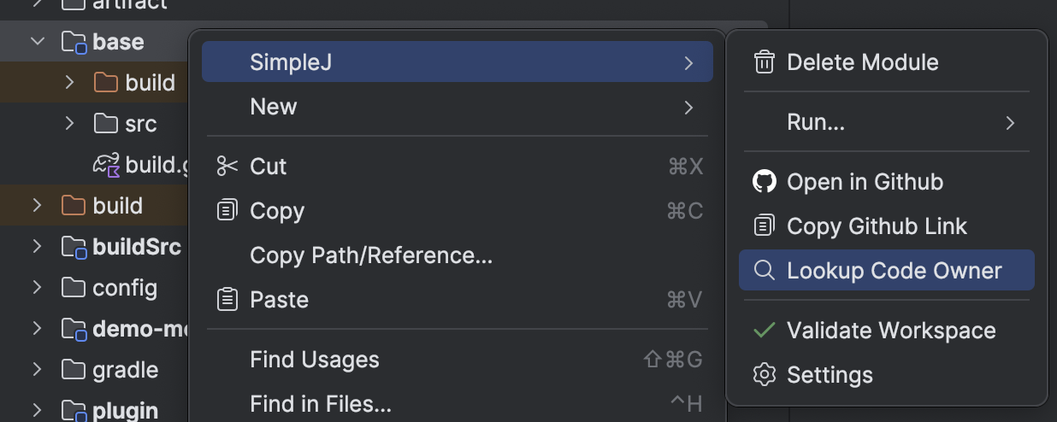
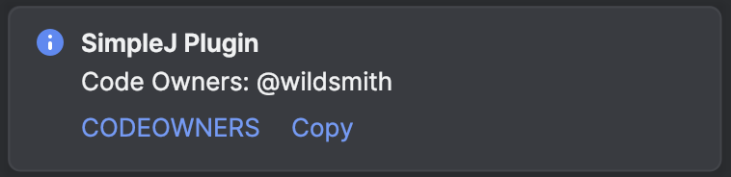
#ᴅʟᴘ_MICRODOT [{'title': 'Data Security Classification', 'text': 'Confidential'}, {'title': 'doc_id', 'text': '12JUmWeewr_0-FSgFp6q-ePuR78R652-tUpR5pDG63Us'}]_END
Code Owner Lookup
Without SimpleJ
With SimpleJ
Right click > SimpleJ > Lookup Code Owner
Search CODEOWNERS for parts of the file path
Ownership claims can use wildcards, making manual searching inaccurate
Order matters so finding the last entry is important
CODEOWNER files can be very noisey
Notes:
When it comes to looking up who owns a tracked file…
Prior to SimpleJ engineers would:
Need to search CODEOWNERS for parts of the file path
Which has many pitfalls as ownership claims can use wildcards, making manually searching faulable
With SimpleJ engineers only need to:
Right click on the tracked file of interest
Click ‘Lookup Code Owner’
Which will prompt a sticky notification with two Actions: one for opening CODEOWNERS to the exact location of the claim and the other for copying the listed code owners for quick sharing

Slide 21
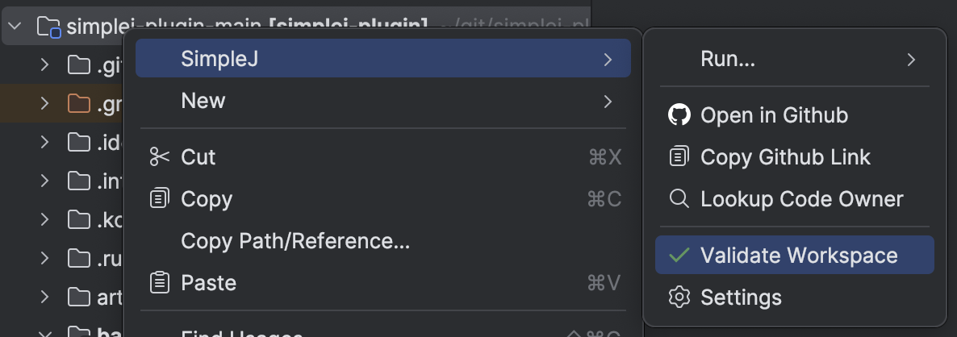
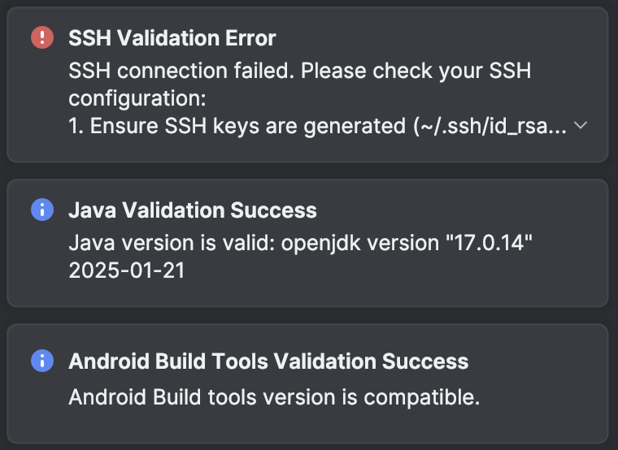
#ᴅʟᴘ_MICRODOT [{'title': 'Data Security Classification', 'text': 'Confidential'}, {'title': 'doc_id', 'text': '12JUmWeewr_0-FSgFp6q-ePuR78R652-tUpR5pDG63Us'}]_END
Workspace Validation
Without SimpleJ
With SimpleJ
Right click > SimpleJ > Validate Workspace
Misconfigured or missing environment variables
Back and forth with support engineers
Often even the best documentation can result in missed steps
Errors appearing as they’re encountered
Notes:
When it comes to validating workspace environment pointers and installed tooling…
Prior to SimpleJ engineers would:
Fix environment issues as they became blockers, which opens the door for silent failures and behavior differences
Despite the best documentation, it’s far too easy to miss workspace configuration steps
All of these things result in a back and forth with support engineers
With SimpleJ engineers only need to:
Right click
Click ‘Validate Workspace’
Which runs 3 main environment inspections. Checking for misaligned Java version or home values, misconfigured SSH keys, and which installed versions of Android’s Build Tools are present
In all this gives users the ability to self service and something to discuss with support engineers

Slide 22
#ᴅʟᴘ_MICRODOT [{'title': 'Data Security Classification', 'text': 'Confidential'}, {'title': 'doc_id', 'text': '12JUmWeewr_0-FSgFp6q-ePuR78R652-tUpR5pDG63Us'}]_END
Browser Overlay
Without SimpleJ
With SimpleJ
Open mapped file > Click the globe icon
Manually finding & opening relevant documentation websites
Context switching between the browser and the IDE
No clear or preferred doc websites for frameworks, projects, or files
Notes:
Bonus! This is a nifty feature that overlays a browser within the IDE. Shout out to Luis Alvarez from one of our Platform teams for not only the idea but implementation.
The reason this is so helpful is bc you can map files or directories to documentation websites.
Prior to SimpleJ engineers would:
Manually find documentation websites
Context switch between the browser and the IDE, opening the door for more distractions
There were no clear preferred doc websites for framework, project or file types
With SimpleJ engineers honestly just need to know that if they need docs and those files have been mapped properly, then clicking on the Globe icon will inline the doc webpage right there.

Slide 23

#ᴅʟᴘ_MICRODOT [{'title': 'Data Security Classification', 'text': 'Confidential'}, {'title': 'doc_id', 'text': '12JUmWeewr_0-FSgFp6q-ePuR78R652-tUpR5pDG63Us'}]_END
Goals: How did SimpleJ do?
- Improve the Developer Experience
- Personalize development environments
- Standardize best practices
- Decrease context switching
- Shorten feedback loops
- Better support & troubleshooting
Notes:
How did SimpleJ do when it came to our goals?
It improved the developer experience through various actions
Allowed for personal dev environment configuration through settings
Standardized best practices through module creation templates
Decreased context switching with Browser Overlays
And provided better troubleshooting and support through workspace validation checks, shareable Github links and quick code owner lookup

Slide 24
#ᴅʟᴘ_MICRODOT [{'title': 'Data Security Classification', 'text': 'Confidential'}, {'title': 'doc_id', 'text': '12JUmWeewr_0-FSgFp6q-ePuR78R652-tUpR5pDG63Us'}]_END
How do we build it?
Notes:
So how do we build IDE Plugin functionality like what we saw in SimpleJ?

Slide 25
#ᴅʟᴘ_MICRODOT [{'title': 'Data Security Classification', 'text': 'Confidential'}, {'title': 'doc_id', 'text': '12JUmWeewr_0-FSgFp6q-ePuR78R652-tUpR5pDG63Us'}]_END
IntelliJ IDE Plugin Basics
- Project Setup
- Project Structure
- plugin.xml
- Defining Actions
- Visualizing Changes
- Prompting a Dialog
- File Writing
- Plugin Distribution
Notes:
Let’s cover some basics of IDE Plugin development, including:
Project setup
Project structure
Defining actions
Visualizing Changes
Prompting for user interaction
Writing updates to file
And, distribution

Slide 26
#ᴅʟᴘ_MICRODOT [{'title': 'Data Security Classification', 'text': 'Confidential'}, {'title': 'doc_id', 'text': '12JUmWeewr_0-FSgFp6q-ePuR78R652-tUpR5pDG63Us'}]_END
IntelliJ IDE Plugin Basics
- Project Setup
- Project Structure
- plugin.xml
- Defining Actions
- Prompting a Dialog
- File Writing
- Plugin Distribution
Note: I am not going to cover integration w/Settings or IDE Plugin Testing
Notes:
Before getting into it I want to callout that this presentation will not cover updates to Settings or Testing.
Testing in particular would likely take up to another 15+ minutes and might be a good idea for a future lightning talk.

Slide 27
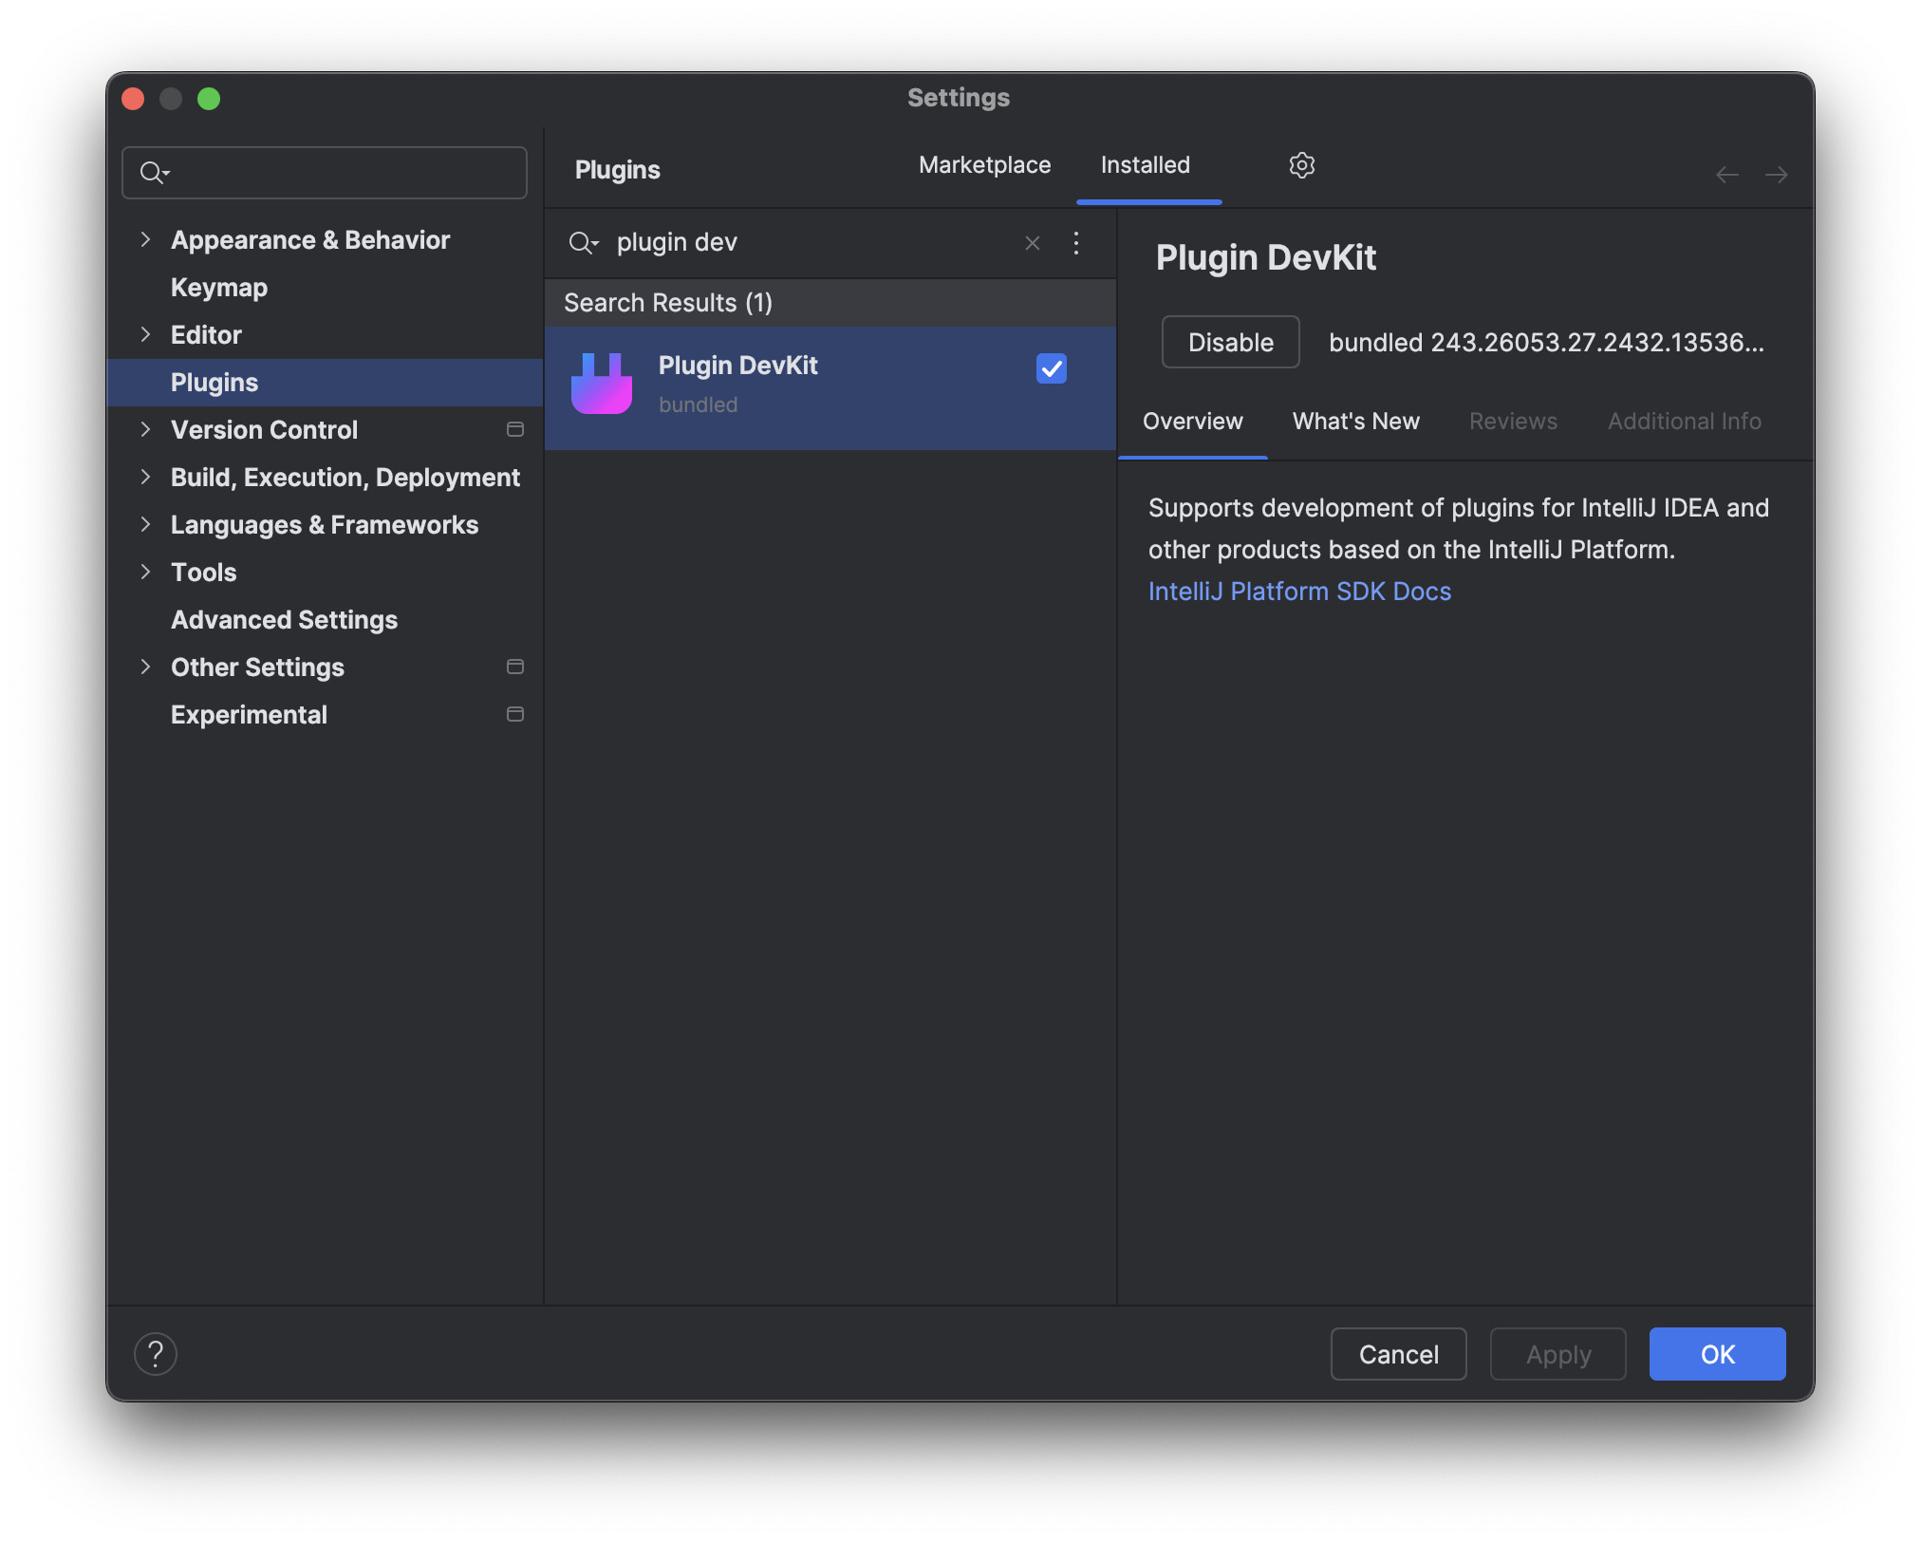
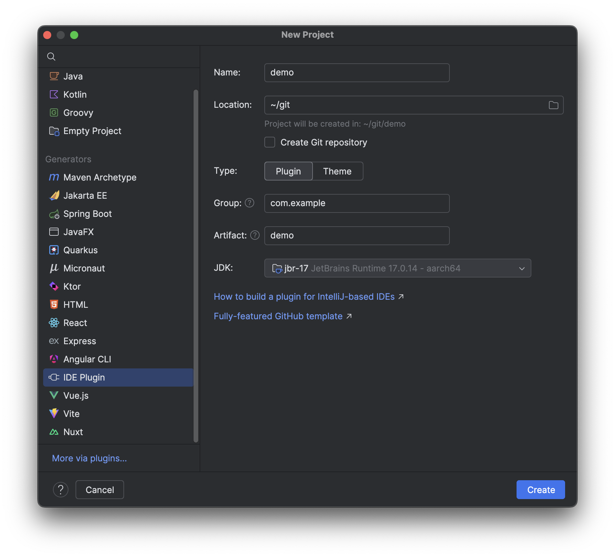
#ᴅʟᴘ_MICRODOT [{'title': 'Data Security Classification', 'text': 'Confidential'}, {'title': 'doc_id', 'text': '12JUmWeewr_0-FSgFp6q-ePuR78R652-tUpR5pDG63Us'}]_END
Project Setup
Install the Plugin DevKit
Create a New Project
Notes:
Assuming that you’re starting from scratch, I would highly recommend creating your project using the IntelliJ Plugin Template, which is extremely easy if you install the Plugin Dev Kit from the IDE Plugin Marketplace.
Creating a new plugin is as easy as File > New Project > And selecting the ‘IDE Plugin’ Generator.

Slide 28
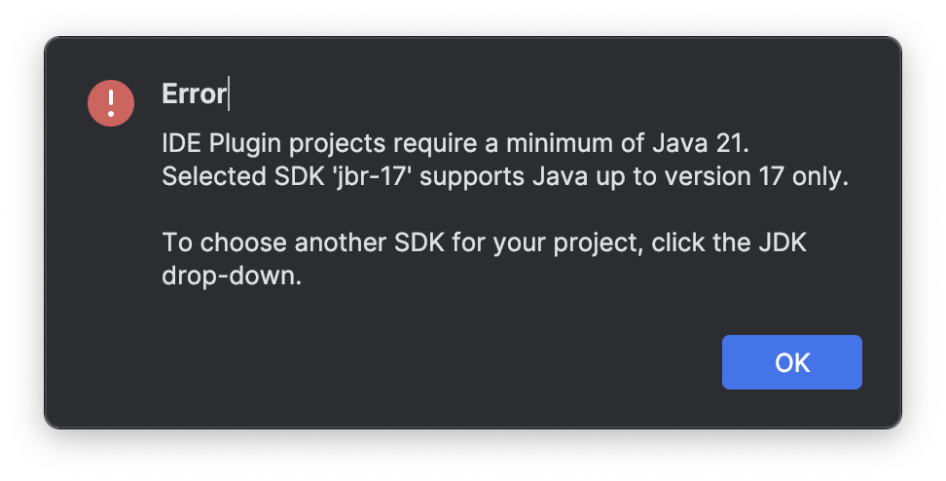
#ᴅʟᴘ_MICRODOT [{'title': 'Data Security Classification', 'text': 'Confidential'}, {'title': 'doc_id', 'text': '12JUmWeewr_0-FSgFp6q-ePuR78R652-tUpR5pDG63Us'}]_END
Project Setup
Install the Plugin DevKit
Create a New Project
Notes:
One Gotcha however. Despite being able to choose which JDK you’d like to target the Plugin DevKit requires at least JDK 21

Slide 29

#ᴅʟᴘ_MICRODOT [{'title': 'Data Security Classification', 'text': 'Confidential'}, {'title': 'doc_id', 'text': '12JUmWeewr_0-FSgFp6q-ePuR78R652-tUpR5pDG63Us'}]_END
Project Structure
├── .github/ GitHub Actions workflows and Dependabot configuration files
├── .run/ Predefined Run/Debug Configurations
├── build/ Output build directory
├── gradle
│ ├── wrapper/ Gradle Wrapper
│ └── libs.versions.toml Gradle version catalog
├── src Plugin sources
│ ├── main
│ │ ├── kotlin/ Kotlin production sources
│ │ └── resources/ Resources - plugin.xml, icons, messages
│ └── test
│ ├── kotlin/ Kotlin test sources
│ └── testData/ Test data used by tests
├── .gitignore Git ignoring rules
├── build.gradle.kts Gradle configuration
├── CHANGELOG.md Full change history
├── gradle.properties Gradle configuration properties
├── gradlew *nix Gradle Wrapper script
├── gradlew.bat Windows Gradle Wrapper script
├── LICENSE License, MIT by default
├── qodana.yml Qodana configuration file
├── README.md README
└── settings.gradle.kts Gradle project settings
Notes:
The resulting project structure output will look something like this. As denoted on their readme there’s a few callouts worth mentioning:
Ensure that you delete all generated code/files that were not needed as well as dependencies that are unused
Qodana: is a smart code quality platform by JetBrains. It does have a pricing model and reports are hosted in the Qodana cloud. Just a heads up.
Kover: a set of solutions for collecting test coverage of Kotlin code. It is still beta, again just another heads up
And finally you may notice that this is a single module setup. Which is not great for scaling larger IDE Plugins with potentially many contributors.

Slide 30
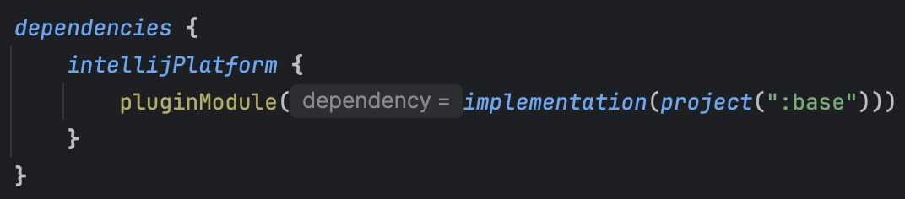
#ᴅʟᴘ_MICRODOT [{'title': 'Data Security Classification', 'text': 'Confidential'}, {'title': 'doc_id', 'text': '12JUmWeewr_0-FSgFp6q-ePuR78R652-tUpR5pDG63Us'}]_END
Project Structure - LEVELED UP
Applied to the host module of the IntelliJ-based plugin project
org.jetbrains.intellij.platform
Other included *IntelliJ aware* subprojects must use the Module plugin
org.jetbrains.intellij.platform.module
Notes:
Luckily through the use of two Gradle Plugin’s we can modularize any IDE Plugin project. The host project must apply the platform plugin (seen in the top box). All other sub-project that are both IntelliJ aware and consumed by the host project must apply the module plugin (seen in the middle box).
Dependencies from the host project to those sub-projects look like the code snippet on the bottom.
Note that in this example the base sub-project has applied the module plugin. The DSL that we see here ensures that base is added to both the implementation dependency configuration and another called intellijPlatformPluginModule.
This guarantees that the sub-project content is merged into the host project’s plugin jar. Otherwise you'd have to write custom Gradle logic to create an Uber jar output from the host…I would know bc I did that and completely missed this additional DSL in the docs.

Slide 31
#ᴅʟᴘ_MICRODOT [{'title': 'Data Security Classification', 'text': 'Confidential'}, {'title': 'doc_id', 'text': '12JUmWeewr_0-FSgFp6q-ePuR78R652-tUpR5pDG63Us'}]_END
Project Structure - LEVELED UP
├── .github/ GitHub Actions workflows and Dependabot configuration files
├── .run/ Predefined Run/Debug Configurations
├── build/ Output build directory
├── gradle
│ ├── wrapper/ Gradle Wrapper
│ └── libs.versions.toml Gradle version catalog
├── base Subproject
│ └── main
├── host Host project
│ └── main
├── .gitignore Git ignoring rules
├── build.gradle.kts Gradle configuration
├── CHANGELOG.md Full change history
├── gradle.properties Gradle configuration properties
├── gradlew *nix Gradle Wrapper script
├── gradlew.bat Windows Gradle Wrapper script
├── LICENSE License, MIT by default
├── qodana.yml Qodana configuration file
├── README.md README
└── settings.gradle.kts Gradle project settings
Notes:
The updated project structure would look something like this.
The project now contains 2 modules, base and host. Sharable extensions go into base while host contains top level logic, Actions, and code specific to the Plugin it outputs.

Slide 32
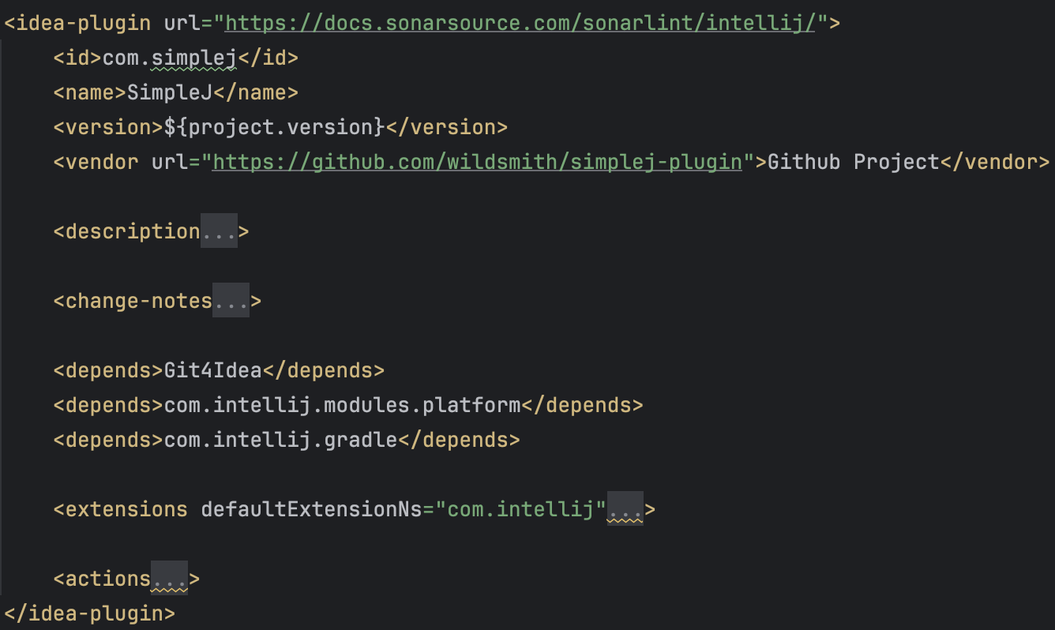
#ᴅʟᴘ_MICRODOT [{'title': 'Data Security Classification', 'text': 'Confidential'}, {'title': 'doc_id', 'text': '12JUmWeewr_0-FSgFp6q-ePuR78R652-tUpR5pDG63Us'}]_END
host > src > main > META-INF > plugin.xml
plugin.xml contains all the information about the plugin, including registered extensions, actions, listeners, etc.
For simple Plugin’s key elements include...
- <id>
- <name>
- <version>
- <description>
- <change-notes>
- <depends>
- <extensions>
- <actions>
Notes:
Within the host project exists a file named plugin.xml. This file reminds me a lot of the AndroidManifest as it creates a blueprint for capabilities and functionality of the IDE Plugin.
For simple Plugin’s some key elements include:
id, name, version, description and change-notes. All being rather obvious in their values.
Depends: Specifies a dependency on another plugin or a module of an IntelliJ Platform-based product., so for instance you could add a dependency on the android plugin
Extensions: Defines plugin extensions, such as notification groups, application services/configurables (for stuff like Plugin settings)
And actions: Defines the plugin actions such as AnActions, these are the most basic entry point to trigger Plugin logic

Slide 33
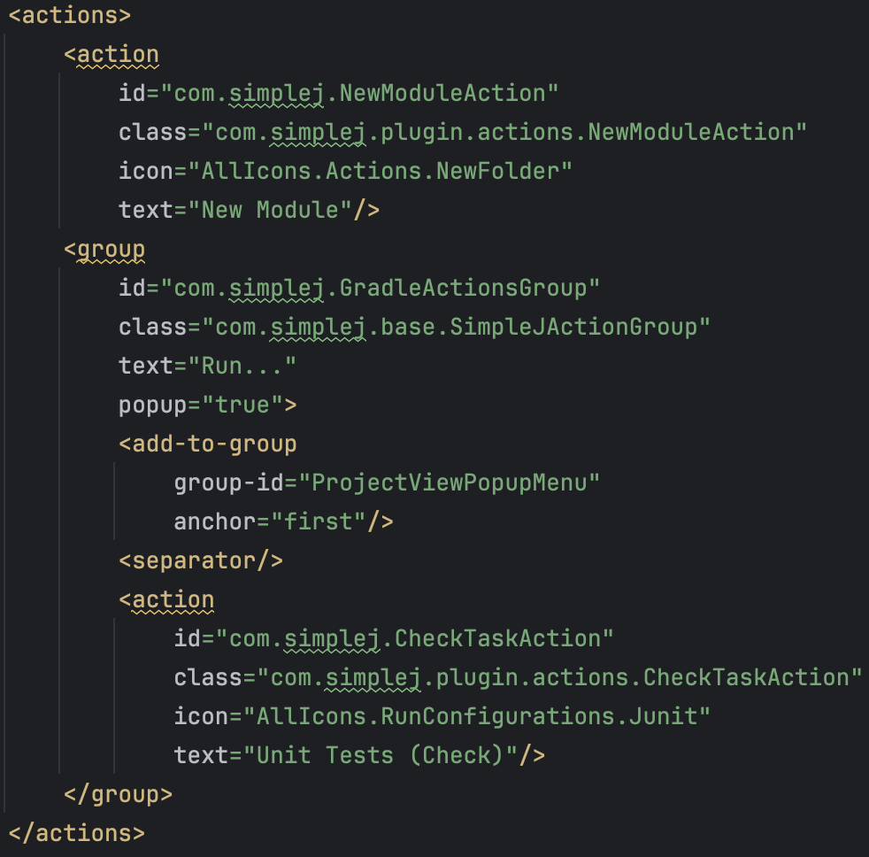
#ᴅʟᴘ_MICRODOT [{'title': 'Data Security Classification', 'text': 'Confidential'}, {'title': 'doc_id', 'text': '12JUmWeewr_0-FSgFp6q-ePuR78R652-tUpR5pDG63Us'}]_END
Defining Actions
host > src > main > META-INF > plugin.xml
<action>s can be declared independently or in <group>s
They can be added to various views, like the Project view menu and/or Editor view menu
To add a little ‘sugar’ consider adding an <icon>
Further conditional display logic can be added within the AnAction
One <action> creates a new module, the other executes the check task
Notes:
Let’s declare two actions
The first one for the creation of new modules. You’ll see that this action is not wrapped in a group.
And the other for executing Gradle’s ‘check’ task. This is nested within a ‘Run..’ Group.
This example demonstrates how Actions can be declared independently from Groups.
And how Actions can be added to various views within the IDE, like the Project and Editor menus.
One minor suggestion is to add a little icon ‘sugar’ to your menu items. This gives users a visual representation of the options available to them.

Slide 34
#ᴅʟᴘ_MICRODOT [{'title': 'Data Security Classification', 'text': 'Confidential'}, {'title': 'doc_id', 'text': '12JUmWeewr_0-FSgFp6q-ePuR78R652-tUpR5pDG63Us'}]_END
Defining Actions
host > src > main > META-INF > plugin.xml
<action>s can be declared independently or in <group>s
They can be added to various views, like the Project view menu and/or Editor view menu
To add a little ‘sugar’ consider adding an <icon>
Further conditional display logic can be added within the AnAction
One <action> creates a new module, the other executes the check task
Note: For simplicity's sake, these actions are under a group called “My Group”, That isn’t seen in the code snippet
Notes:
For simplicity's sake these actions are under a group called ‘My Group’ which is not seen in the code snippet.

Slide 35
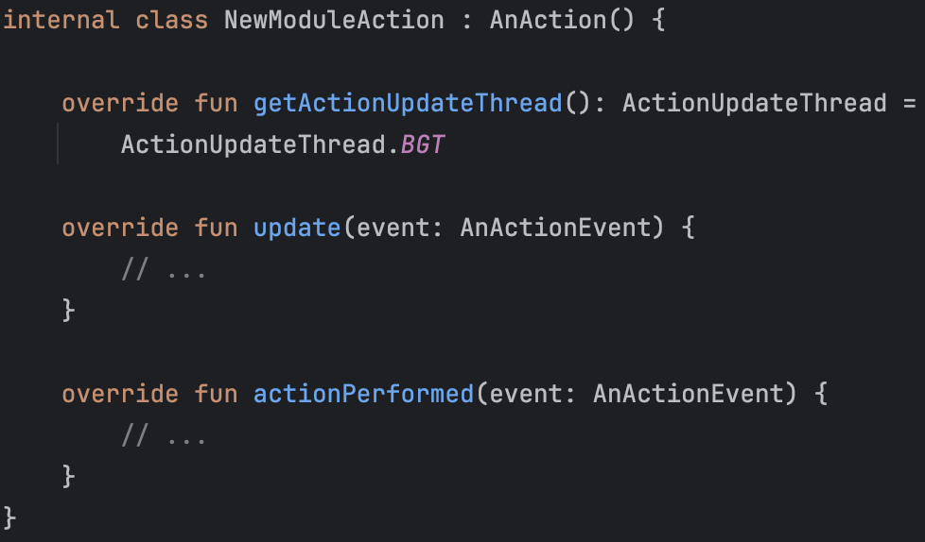
#ᴅʟᴘ_MICRODOT [{'title': 'Data Security Classification', 'text': 'Confidential'}, {'title': 'doc_id', 'text': '12JUmWeewr_0-FSgFp6q-ePuR78R652-tUpR5pDG63Us'}]_END
host > src > main > kotlin > ... > NewModuleAction.kt
Specifies the thread and the way AnAction.update or other update-like methods shall be called
Updates the presentation of the action; aka visibility.
Performs the action.
It is called on the UI thread.
Notes:
Let’s take a look at NewModuleAction’s code.
NewModuleAction extends from AnAction. The IntelliJ Platform calls methods of registered AnActions when a user interacts with a menu or toolbar.
There are three main functions of an AnAction:
getActionUpdateThread(), which determines the thread on which update() will be called
update(), which can change the presentation of the action, like changing its visibility
And, actionPerformed(), which performs the action while executing on the UI thread

Slide 36
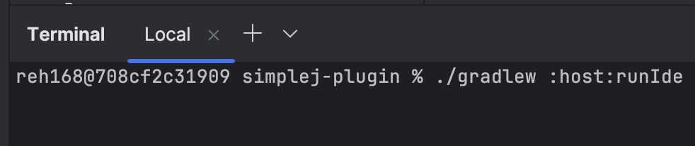

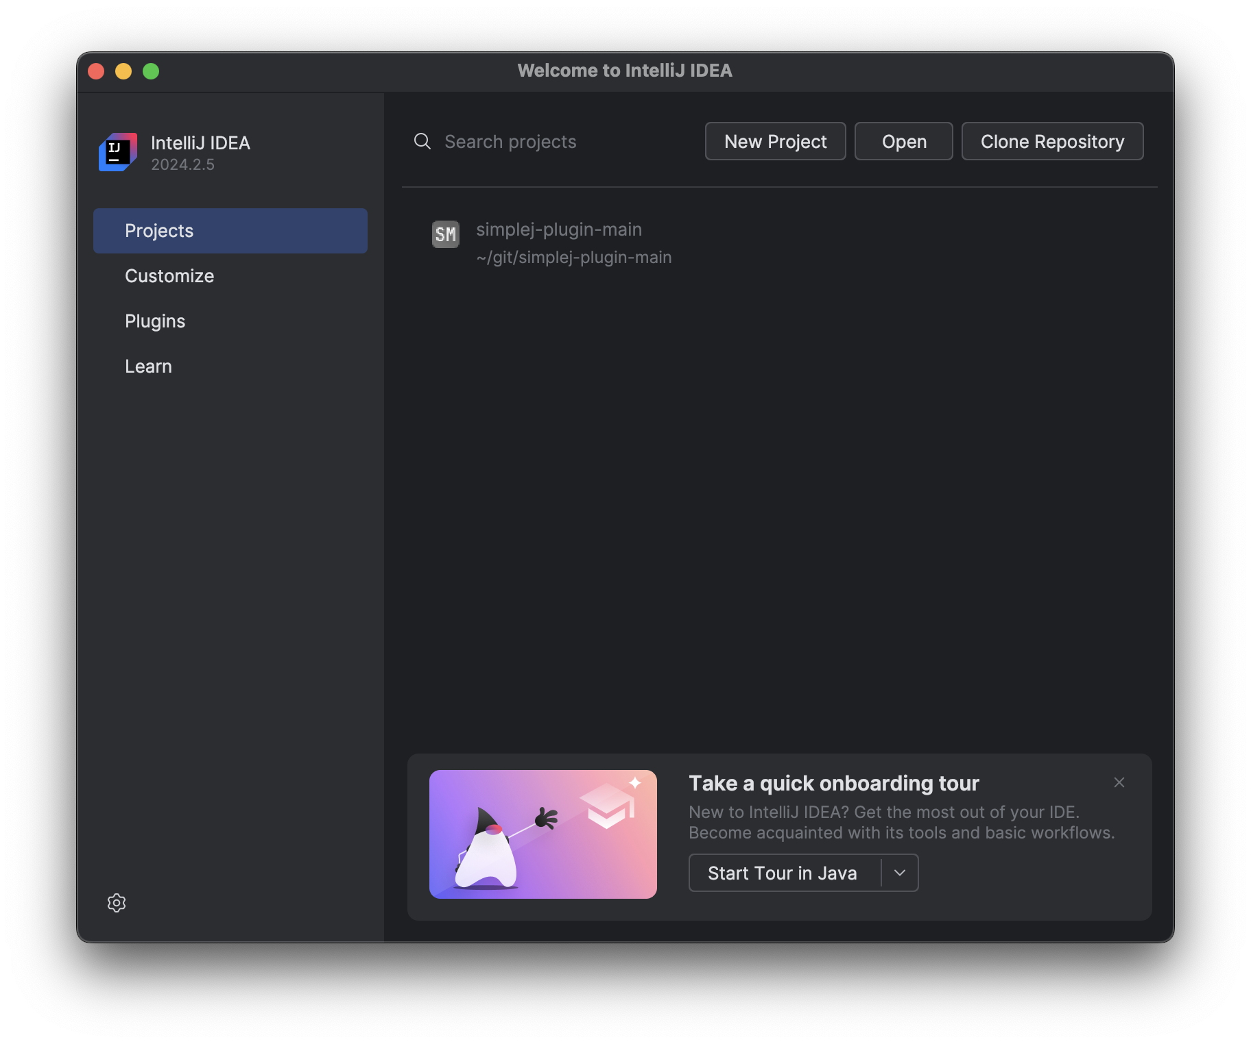
#ᴅʟᴘ_MICRODOT [{'title': 'Data Security Classification', 'text': 'Confidential'}, {'title': 'doc_id', 'text': '12JUmWeewr_0-FSgFp6q-ePuR78R652-tUpR5pDG63Us'}]_END
Visualizing Changes
Execute the runIde Gradle Task
Launching a development IDE instance
Debuggable by adding --debug-jvm
Notes:
We can quickly visualize our new Actions by launching a development IDE instance. This is accomplished by executing the runIde Gradle task.
Worth calling out, the runIde Gradle task has options that allow you to specify how the development IDE behaves and loads.
Additionally this development IDE is debuggable through the use of the --debug-jvm task option and an accompanying Remote JVM Debug run configuration.

Slide 37
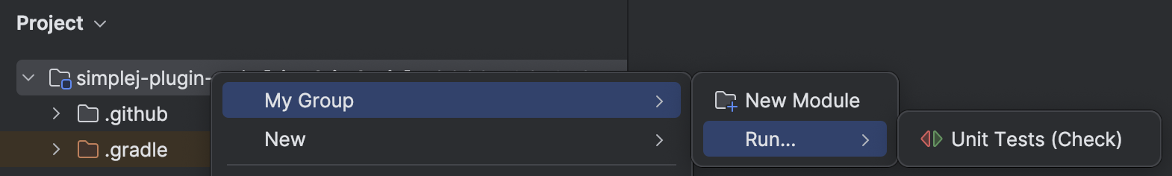
#ᴅʟᴘ_MICRODOT [{'title': 'Data Security Classification', 'text': 'Confidential'}, {'title': 'doc_id', 'text': '12JUmWeewr_0-FSgFp6q-ePuR78R652-tUpR5pDG63Us'}]_END
Visualizing Changes
Right clicking a project from within the Project panel reveals our new <action>s
One of the <action>s is nested within the ‘Run...‘ group
Notice the <icon> ‘sugar’ to the left of each <action>
Notes:
As we can see, when I right-click on root directory I’m presented with ‘My Group’ and the two Actions we added.
A couple things to point out:
Notice the location and grouping of the actions as a direct result of using Groups
And the icon sugar to the left of each Action

Slide 38
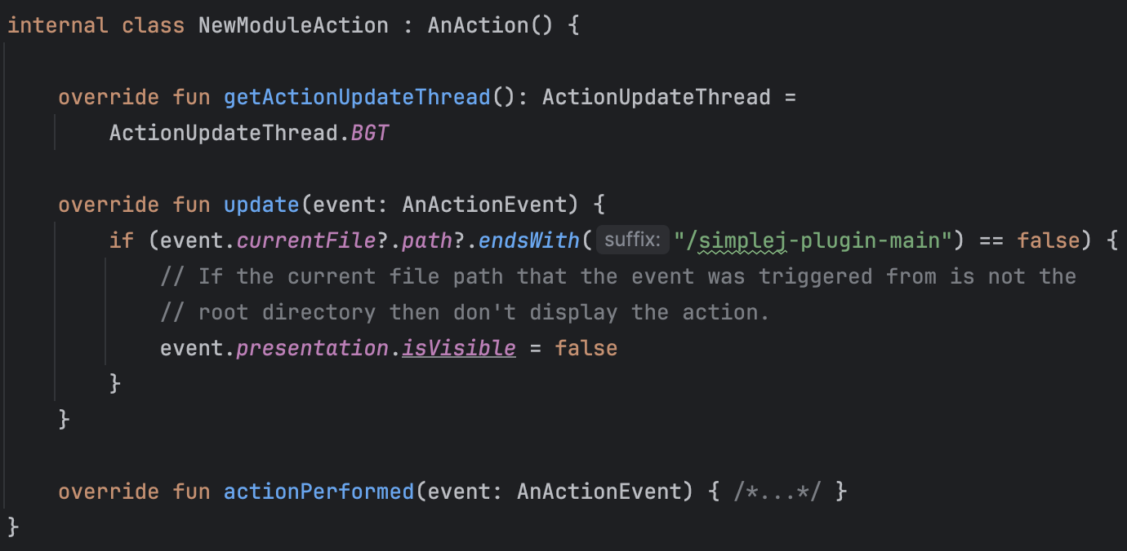
#ᴅʟᴘ_MICRODOT [{'title': 'Data Security Classification', 'text': 'Confidential'}, {'title': 'doc_id', 'text': '12JUmWeewr_0-FSgFp6q-ePuR78R652-tUpR5pDG63Us'}]_END
Bonus: Additional Conditional Display
Notes:
Within the New Module AnAction

Slide 39
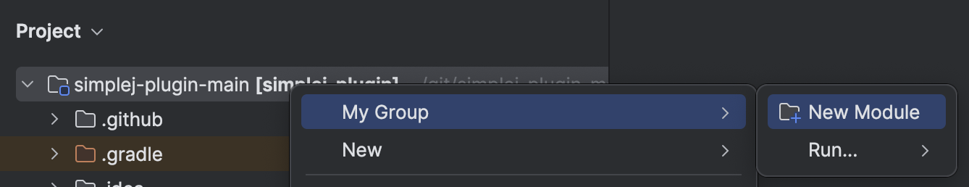
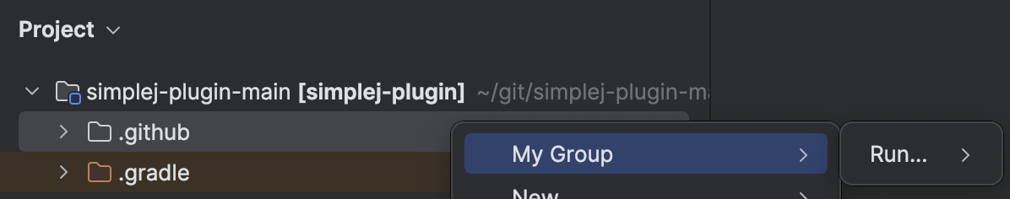
#ᴅʟᴘ_MICRODOT [{'title': 'Data Security Classification', 'text': 'Confidential'}, {'title': 'doc_id', 'text': '12JUmWeewr_0-FSgFp6q-ePuR78R652-tUpR5pDG63Us'}]_END
Bonus: Additional Conditional Display
Matching Directory
Mismatched Directory

Slide 40
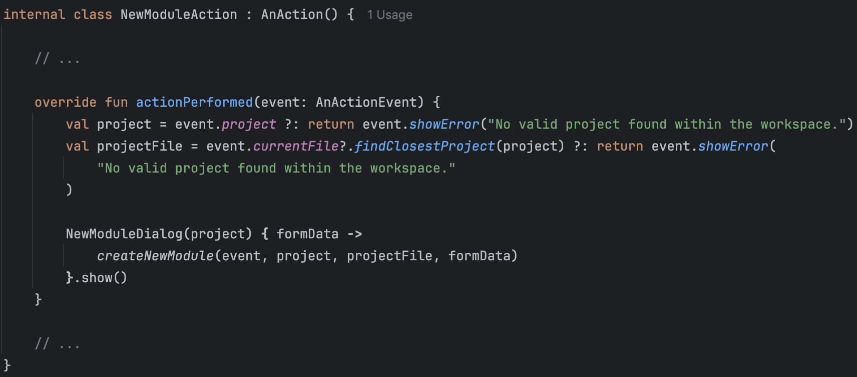
#ᴅʟᴘ_MICRODOT [{'title': 'Data Security Classification', 'text': 'Confidential'}, {'title': 'doc_id', 'text': '12JUmWeewr_0-FSgFp6q-ePuR78R652-tUpR5pDG63Us'}]_END
Prompting a Dialog
Notes:
Within the NewModuleActions actionPerform() function we’re going to validate that we have non-null project and projectFile pointers.
Something worth calling out is that event.project will typically always return the root project present in the workspace - NOT the project closest to the event (or file) that triggered the action.
Now let’s prompt a dialog for the user to fill out.
We’ll return to the createNewModule function in a second.

Slide 41
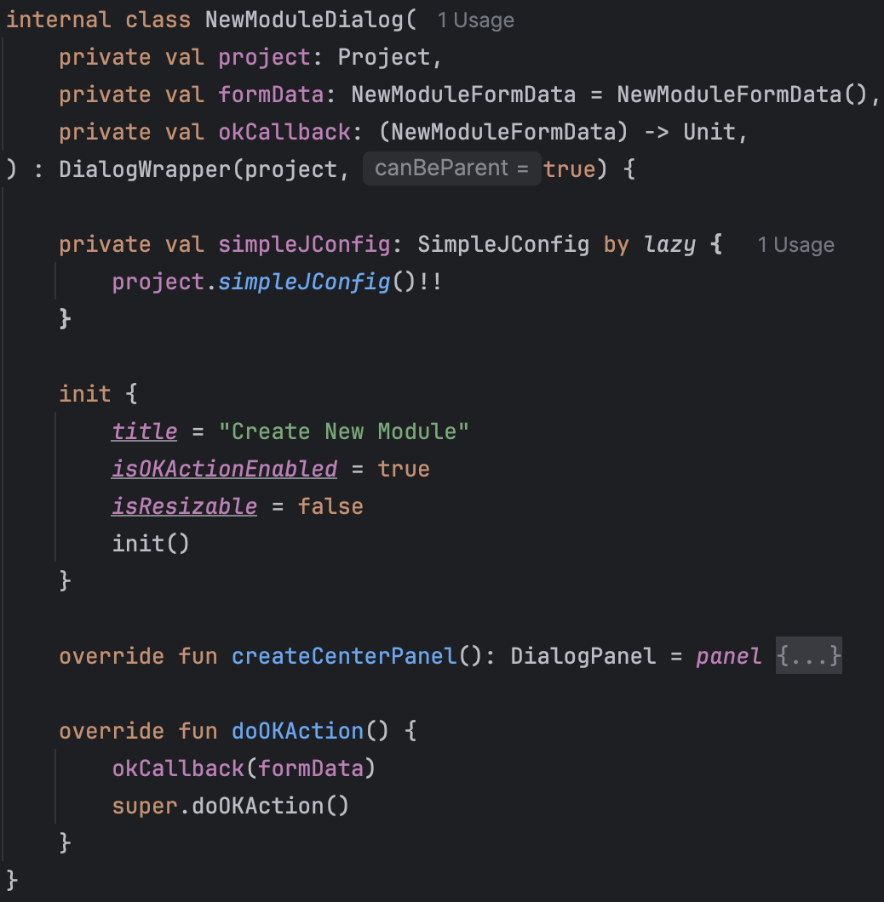
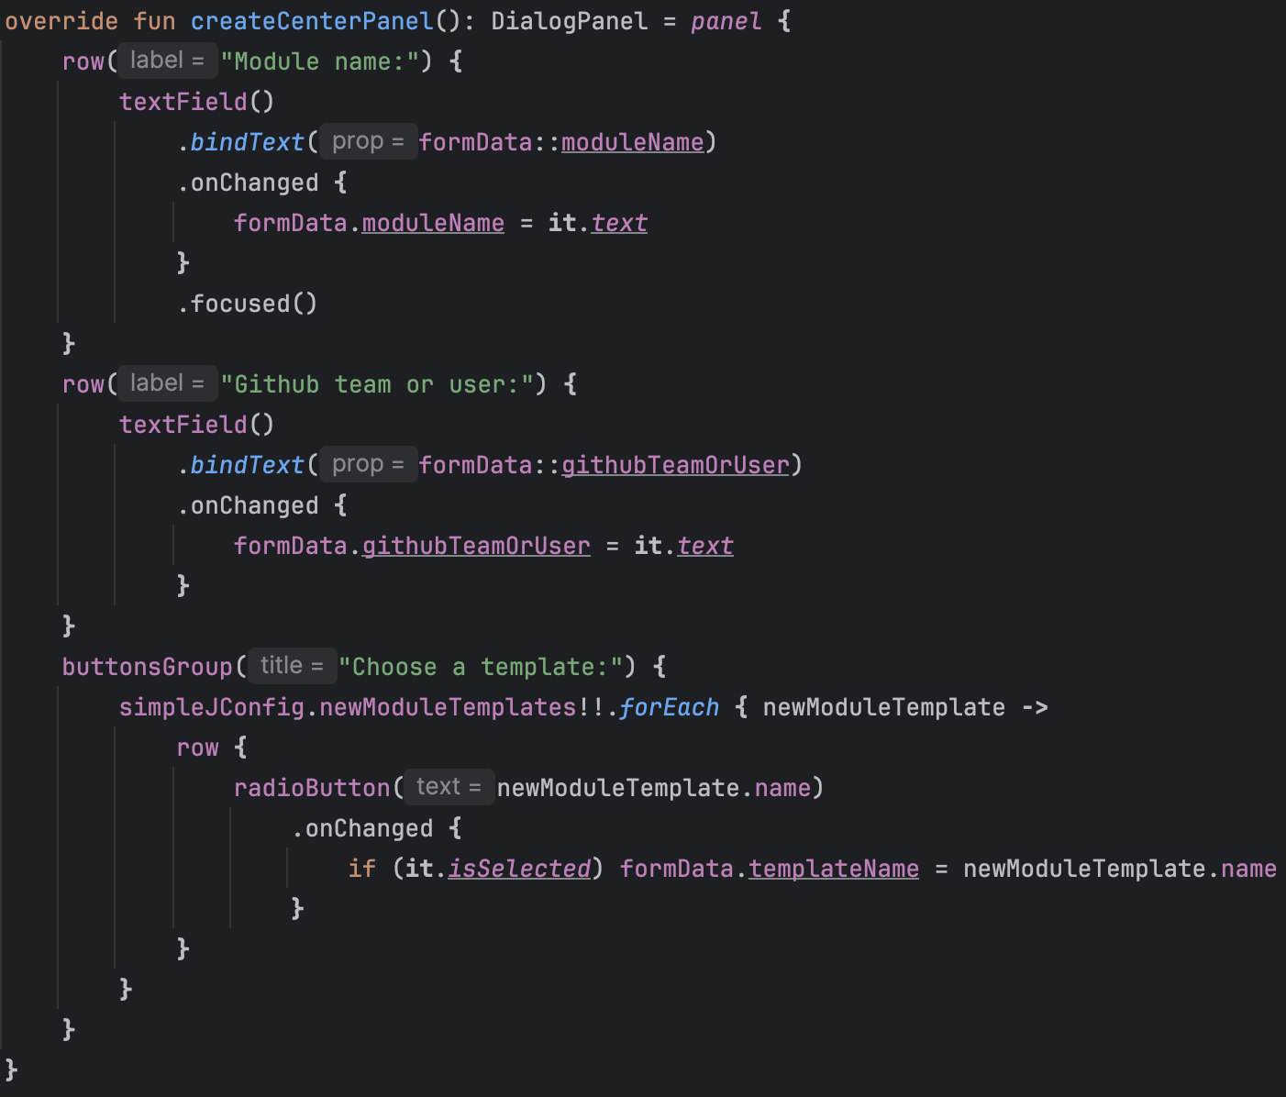
#ᴅʟᴘ_MICRODOT [{'title': 'Data Security Classification', 'text': 'Confidential'}, {'title': 'doc_id', 'text': '12JUmWeewr_0-FSgFp6q-ePuR78R652-tUpR5pDG63Us'}]_END
Dialog using Kotlin UI DSL
Notes:
Kotlin DSL source page
In this example NewModuleDialog extends IntelliJ’s DialogWrapper while setting a couple fields:
The dialog title is set to “Create New Module”
We’re informing the IDE that the dialog should both show an OK/Cancel button as well as callback to the Dialog when the user clicks OK
And, ensuring the user cannot resize the dialog
On the right we’re building out the Dialogs center panel using IntelliJ’s Kotlin UI DSL V2. The DSL defines:
A row for the module name with accompanying input field
A row for the github team or name with accompanying input field
And a dynamically populated series of radio buttons informed by SimpleJ’s config json file

Slide 42
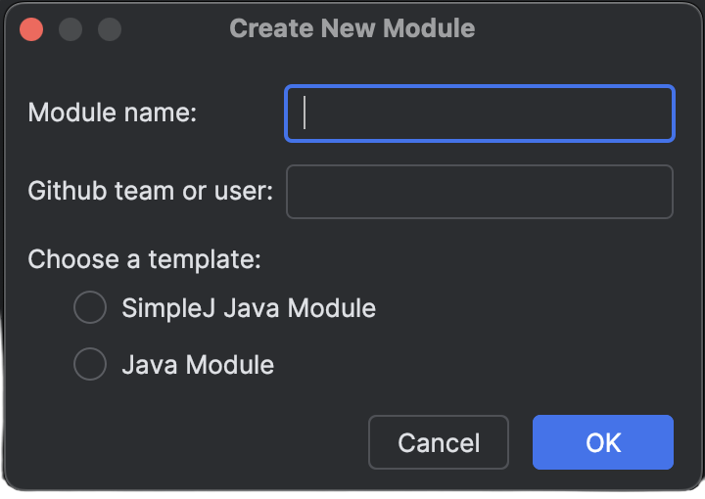
#ᴅʟᴘ_MICRODOT [{'title': 'Data Security Classification', 'text': 'Confidential'}, {'title': 'doc_id', 'text': '12JUmWeewr_0-FSgFp6q-ePuR78R652-tUpR5pDG63Us'}]_END
Dialog using Kotlin UI DSL
Notes:
And this is what it looks like when prompted.

Slide 43
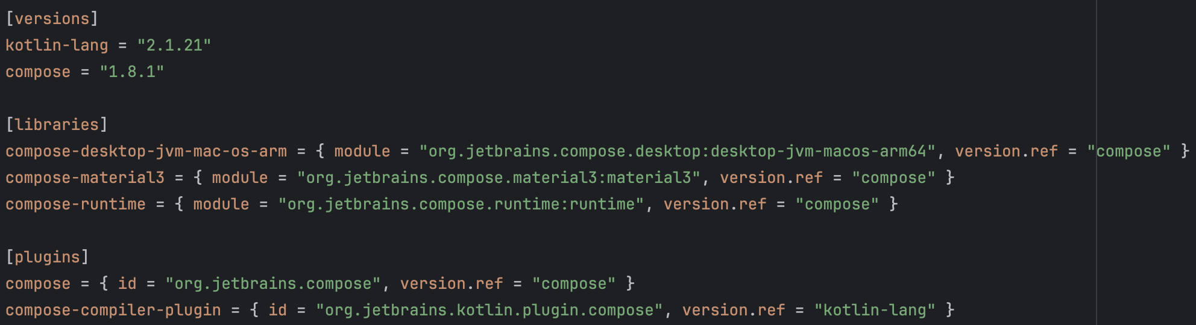
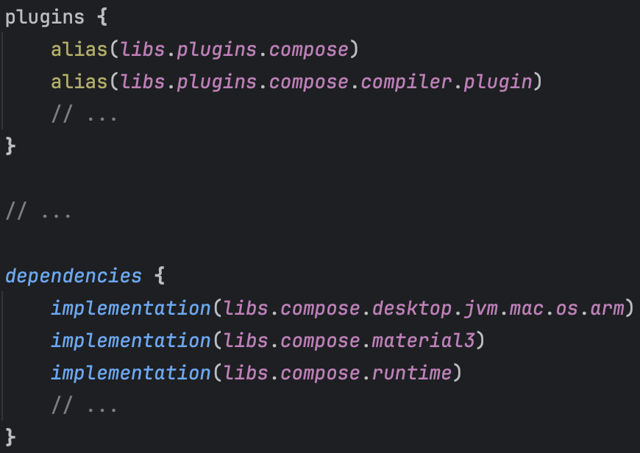
#ᴅʟᴘ_MICRODOT [{'title': 'Data Security Classification', 'text': 'Confidential'}, {'title': 'doc_id', 'text': '12JUmWeewr_0-FSgFp6q-ePuR78R652-tUpR5pDG63Us'}]_END
Dialog using Compose Desktop
Update your toml file
Update your build file
Notes:
However, what if we wanted to use Compose Desktop instead of the Kotlin UI DSL?
You’d first need to add a mix of the above to your dependencies toml file as well as place dependencies on those libraries within the project’s build file.

Slide 44
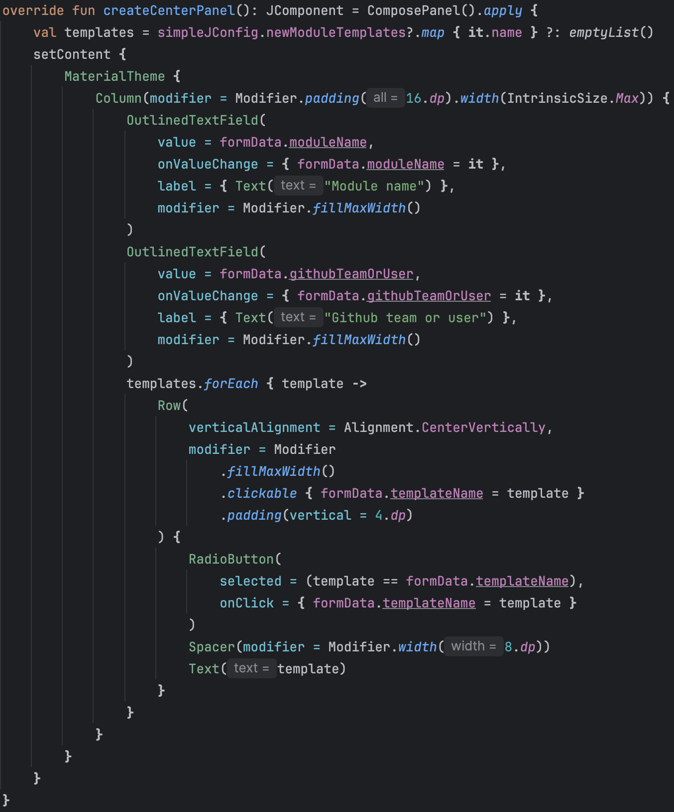
#ᴅʟᴘ_MICRODOT [{'title': 'Data Security Classification', 'text': 'Confidential'}, {'title': 'doc_id', 'text': '12JUmWeewr_0-FSgFp6q-ePuR78R652-tUpR5pDG63Us'}]_END
Dialog using Compose Desktop
Notes:
This is the same exact setup as the original NewModuleDialog except for the center panel is now using Compose Desktop.
Please ignore the my Compose if it looks terrible. I blame Gemini Pro. Unless it looks good, then it was all me.

Slide 45
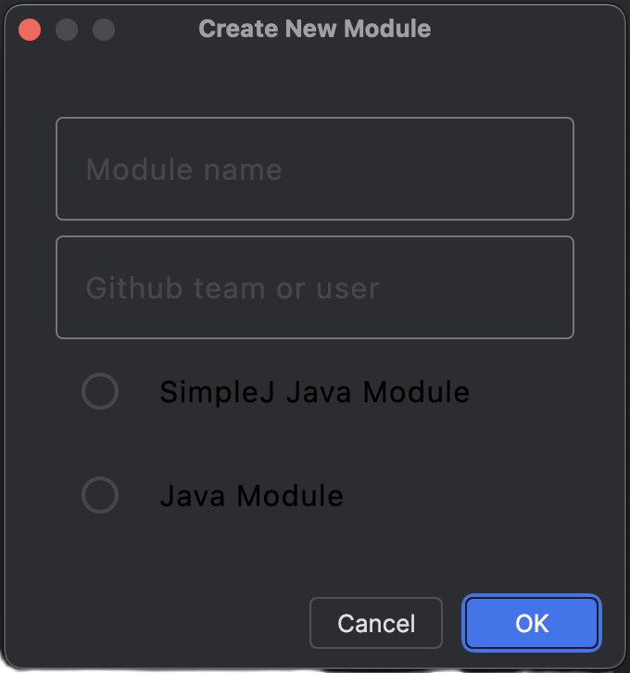
#ᴅʟᴘ_MICRODOT [{'title': 'Data Security Classification', 'text': 'Confidential'}, {'title': 'doc_id', 'text': '12JUmWeewr_0-FSgFp6q-ePuR78R652-tUpR5pDG63Us'}]_END
Dialog using Compose Desktop
Notes:
I’ll be the first to point out that the dialog here needs some TLC. BUT the point still stands, Compose Desktop is an option when building out an array of Plugin IDE UI.

Slide 46
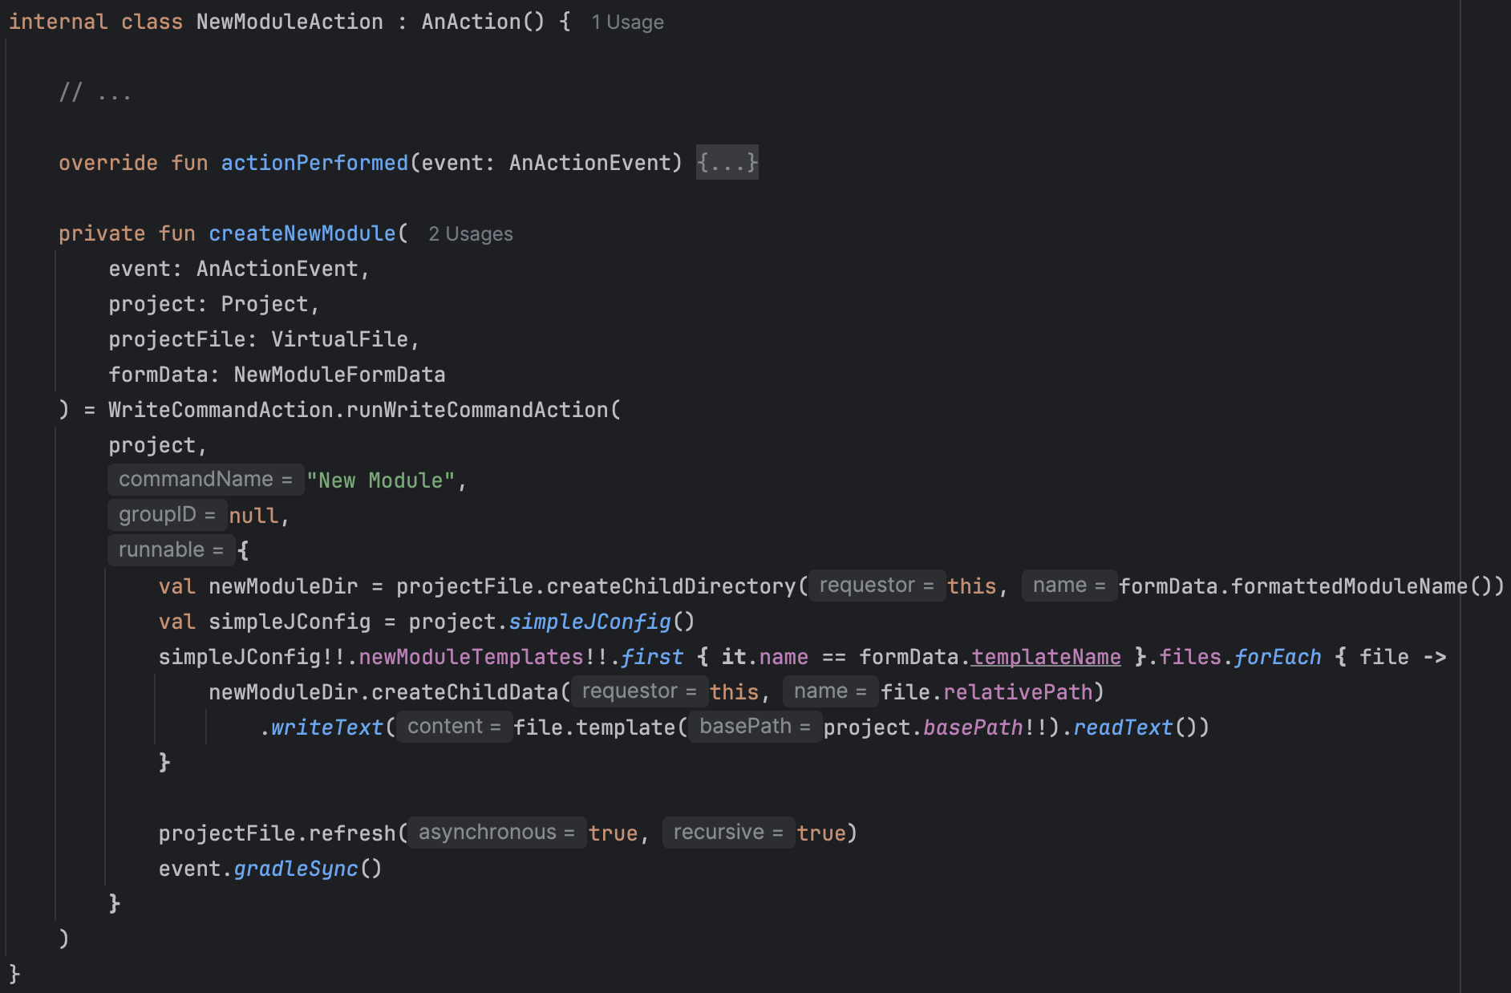
#ᴅʟᴘ_MICRODOT [{'title': 'Data Security Classification', 'text': 'Confidential'}, {'title': 'doc_id', 'text': '12JUmWeewr_0-FSgFp6q-ePuR78R652-tUpR5pDG63Us'}]_END
Creating the new module
Inform the IDE of file changes using...
- WriteCommandAction’s
- VirtualFile’s, similar to File but monitored by the IDE’s VFS
- VirtualFile functions & extensions for Dir/File updates
File updates must be backgrounded
File reads do not require VirtualFile or background threading
Notes:
Once the user has completely filled out the dialog and clicked OK. We need to create the new module and it’s files.
The way you do this with an IDE Plugin is by using the WriteCommandAction, which throws the file IO onto a background thread and tracks the file IO performed.
This matters as it gives users the ability to easily undo the module creation and any other updates to accompanying files.
Some things to call out:
When interacting with Files try to favor VirtualFile’s over java.io.File as VirtualFiles are monitored by the IDE’s VFS
File updates must be backgrounded
File reads do not require VirtualFile or background threading; however VirtualFiles are still preferred.

Slide 47
#ᴅʟᴘ_MICRODOT [{'title': 'Data Security Classification', 'text': 'Confidential'}, {'title': 'doc_id', 'text': '12JUmWeewr_0-FSgFp6q-ePuR78R652-tUpR5pDG63Us'}]_END
Plugin Distribution
JetBrains Marketplace
Custom Plugin Repo
Installed from Disk
First uploads are manual
Requires a JetBrains Account
Signed artifact uploading via Gradle Tasks
Custom release channels
Globally public
Create and maintain an updatePlugins.xml
Host Plugin artifacts on your own HTTPS web server
Use Gradle to upload Plugin artifacts
No JetBrains account required
Scoped visibility
Install the zip or jar manually
Requires broadcasting upgrade availability
Scoped visibility
Notes:
There are three primary ways to distribute Plugins:
Jetbrains Marketplace:
Wherein first uploads are manual.
From then on out you’d be using Gradle Tasks with generated tokens and signing keys. One fun bit is that you can specify any name for your release channel, it’s open season which is interesting. But that does require your consumers to add the channel to their IDE to see the Plugin.
Some cons are that it’s globally public, which means if you’re building a plugin private to your company this is likely not an option.
Custom Plugin Repo’s:
You’ll have to create and maintain an updatePlugins.xml file. This file contains information about the available Plugins in the hosted repository. Luckily there’s a Gradle Plugin to automate the upload of the plugin’s zip as well as creation of the updatePlugins.xml file.
Because you own the hosted repository it can be as open or walled garden as you want. Just be sure to let your consumers know the end point so they can add it to their IDE.
And finally, Installation from Disk:
The title pretty much says it all. Once you have the zip or jar you can install it from disk.
The serious drawback of this is manually reinstalling the artifact when it has changes. And for large audiences this requires broadcasting the update.
However there are ways to script it such that disk updates are automatically applied.
It’s worth mentioning that Plugin’s can also be installed via CLI.

Slide 48
#ᴅʟᴘ_MICRODOT [{'title': 'Data Security Classification', 'text': 'Confidential'}, {'title': 'doc_id', 'text': '12JUmWeewr_0-FSgFp6q-ePuR78R652-tUpR5pDG63Us'}]_END
Plugin Distribution
JetBrains Marketplace
Custom Plugin Repo
Installed from Disk
First uploads are manual
Requires a JetBrains Account
Signed artifact uploading via Gradle Tasks
Custom release channels
Globally public
Create and maintain an updatePlugins.xml
Host Plugin artifacts on your own HTTPS web server
Use Gradle to upload Plugin artifacts
No JetBrains account required
Scoped visibility
Install the zip or jar manually
Requires broadcasting upgrade availability
Scoped visibility
Pro Tip: You can require specific Plugins for projects. This can be helpful to codify developer behaviors and utilities. Update .idea/externalDependencies.xml
Notes:
Pro Tip: you can configure your project to require plugins that provide support for certain technologies or frameworks.
The IDE will notify users of the project if they forgot to install the plugin, or someone on your team is not aware about the dependency as they work on the project.
This can be helpful for companies with high engineer headcount and/or with diverse levels of experience.

Slide 49
#ᴅʟᴘ_MICRODOT [{'title': 'Data Security Classification', 'text': 'Confidential'}, {'title': 'doc_id', 'text': '12JUmWeewr_0-FSgFp6q-ePuR78R652-tUpR5pDG63Us'}]_END
Final Thoughts
Notes:
Final thoughts while putting together this presentation and the SimpleJ project…

Slide 50
#ᴅʟᴘ_MICRODOT [{'title': 'Data Security Classification', 'text': 'Confidential'}, {'title': 'doc_id', 'text': '12JUmWeewr_0-FSgFp6q-ePuR78R652-tUpR5pDG63Us'}]_END
When Writing Plugins...
Initial project setup is easy
Finding concise and up-to-date Action, Extension, and Service code samples is difficult
There are a lot of {DoAThing}Managers
Swing seems to still be the primary UI kit
Swing form editors (with preview) are behind a paywall
The Swing based Kotlin UI DSL is nice(ish)
Notes:
In terms of writing the code…
Jetbrains has amassed a large amount of documentation, which was helpful during initial project setup
Once creating Actions, Extensions, and Services it became difficult to find maintained code samples
There are a lot of Managers, some with some moderate overlap. It’s not clear which ones to use when.
Swing still being the primary way of building UI is odd given Jetbrains leadership with Compose. I get it as the IDE has been around for much longer.
Swing form editors being behind IntelliJ Ultimates pay wall hinders Plugin creation and the Kotlin DSL has no preview functionality
The Kotlin UI DSL is nice-ish but it’s unclear how exactly to setup your panels and the code samples for it are not straightforward

Slide 51
#ᴅʟᴘ_MICRODOT [{'title': 'Data Security Classification', 'text': 'Confidential'}, {'title': 'doc_id', 'text': '12JUmWeewr_0-FSgFp6q-ePuR78R652-tUpR5pDG63Us'}]_END
When Using Compose Desktop...
Jewel (The JetBrains theme for Compose Desktop) is almost ready
Kotlin UI DSLs still seem to be much less verbose & get theming for free
Favor Compose Desktop for UI creation *sometimes*
Previewing Composables is clunky
Adding Compose dependencies bloated SimpleJ’s Plugin binary by ~94%
Notes:
In terms of using Compose Desktop…
Jewel, the theme built by Jetbrains for Compose desktop, isn’t stable yet and trying to use it while on older Kotlin/Compose versions proved problematic. Their repo is archived as of Arpil and it’s moved to the IntelliJ Platform but hasn’t released a new version or outlined clear integration/compatibility just yet
Kotlin UI DSLs seem much less verbose, we saw the code snippets earlier in the presentation. And you get full theming support for free. However there’s no previewing of the UI and the roundtrip of validations via a development environment IDE is slow.
Imo, favor Compose Desktop for UI creation *sometimes*. You can do everything Swing can do with Compose Desktop but getting the theming and primitives right is a pain and unfortunately unless you can your Compose panels stick out. If that doesn’t matter to you then by all means go full Compose.
Adding the Compose Desktop dependencies bloated SimpleJ’s Plugin binary by roughly 94%. Without Compose Desktop SimpleJ has a footprint of 2.5mb and with Compose Desktop that jumps to 39.8mb. IntelliJ’s recommendation is to try to keep the binary size of Plugins low. So take that into consideration when adding Compose to your Plugin.

Slide 52




#ᴅʟᴘ_MICRODOT [{'title': 'Data Security Classification', 'text': 'Confidential'}, {'title': 'doc_id', 'text': '12JUmWeewr_0-FSgFp6q-ePuR78R652-tUpR5pDG63Us'}]_END
Previewing Composables
(Android’s) Automatic Preview
Kotlin Multiplatform
[Optional] When using non-Android Studio Jetbrains IDE install these Plugins...
- Android
- Android Design Tools
- Jetpack Compose
Create an Android Library module to preview Composables
Automatic re-rendering on code changes
Install Kotlin Multiplatform
Upon code changes manually click the compose preview gutter icon
Easy-er
Medium-ish
Notes:
Previewing your Composables also comes with some options.
You can leverage an Android library solely for previewing Composables. This is the first option on the left and what I choose to do for SimpleJ. When not using Android Studio be sure to install the Android, Android Design Tools and Jetpack Compose IDE Plugins. All of these essentially come pre-bundled when using Android Studio. The benefit of this approach is an automatic re-rendering upon code changes.
Or you can stick to the more traditional Compose Desktop setup by installing the Kotlin Multiplatform IDE Plugin but that requires you to manually click the compose preview gutter icon. It also does some interesting things to the package tree in the project panel.

Slide 53
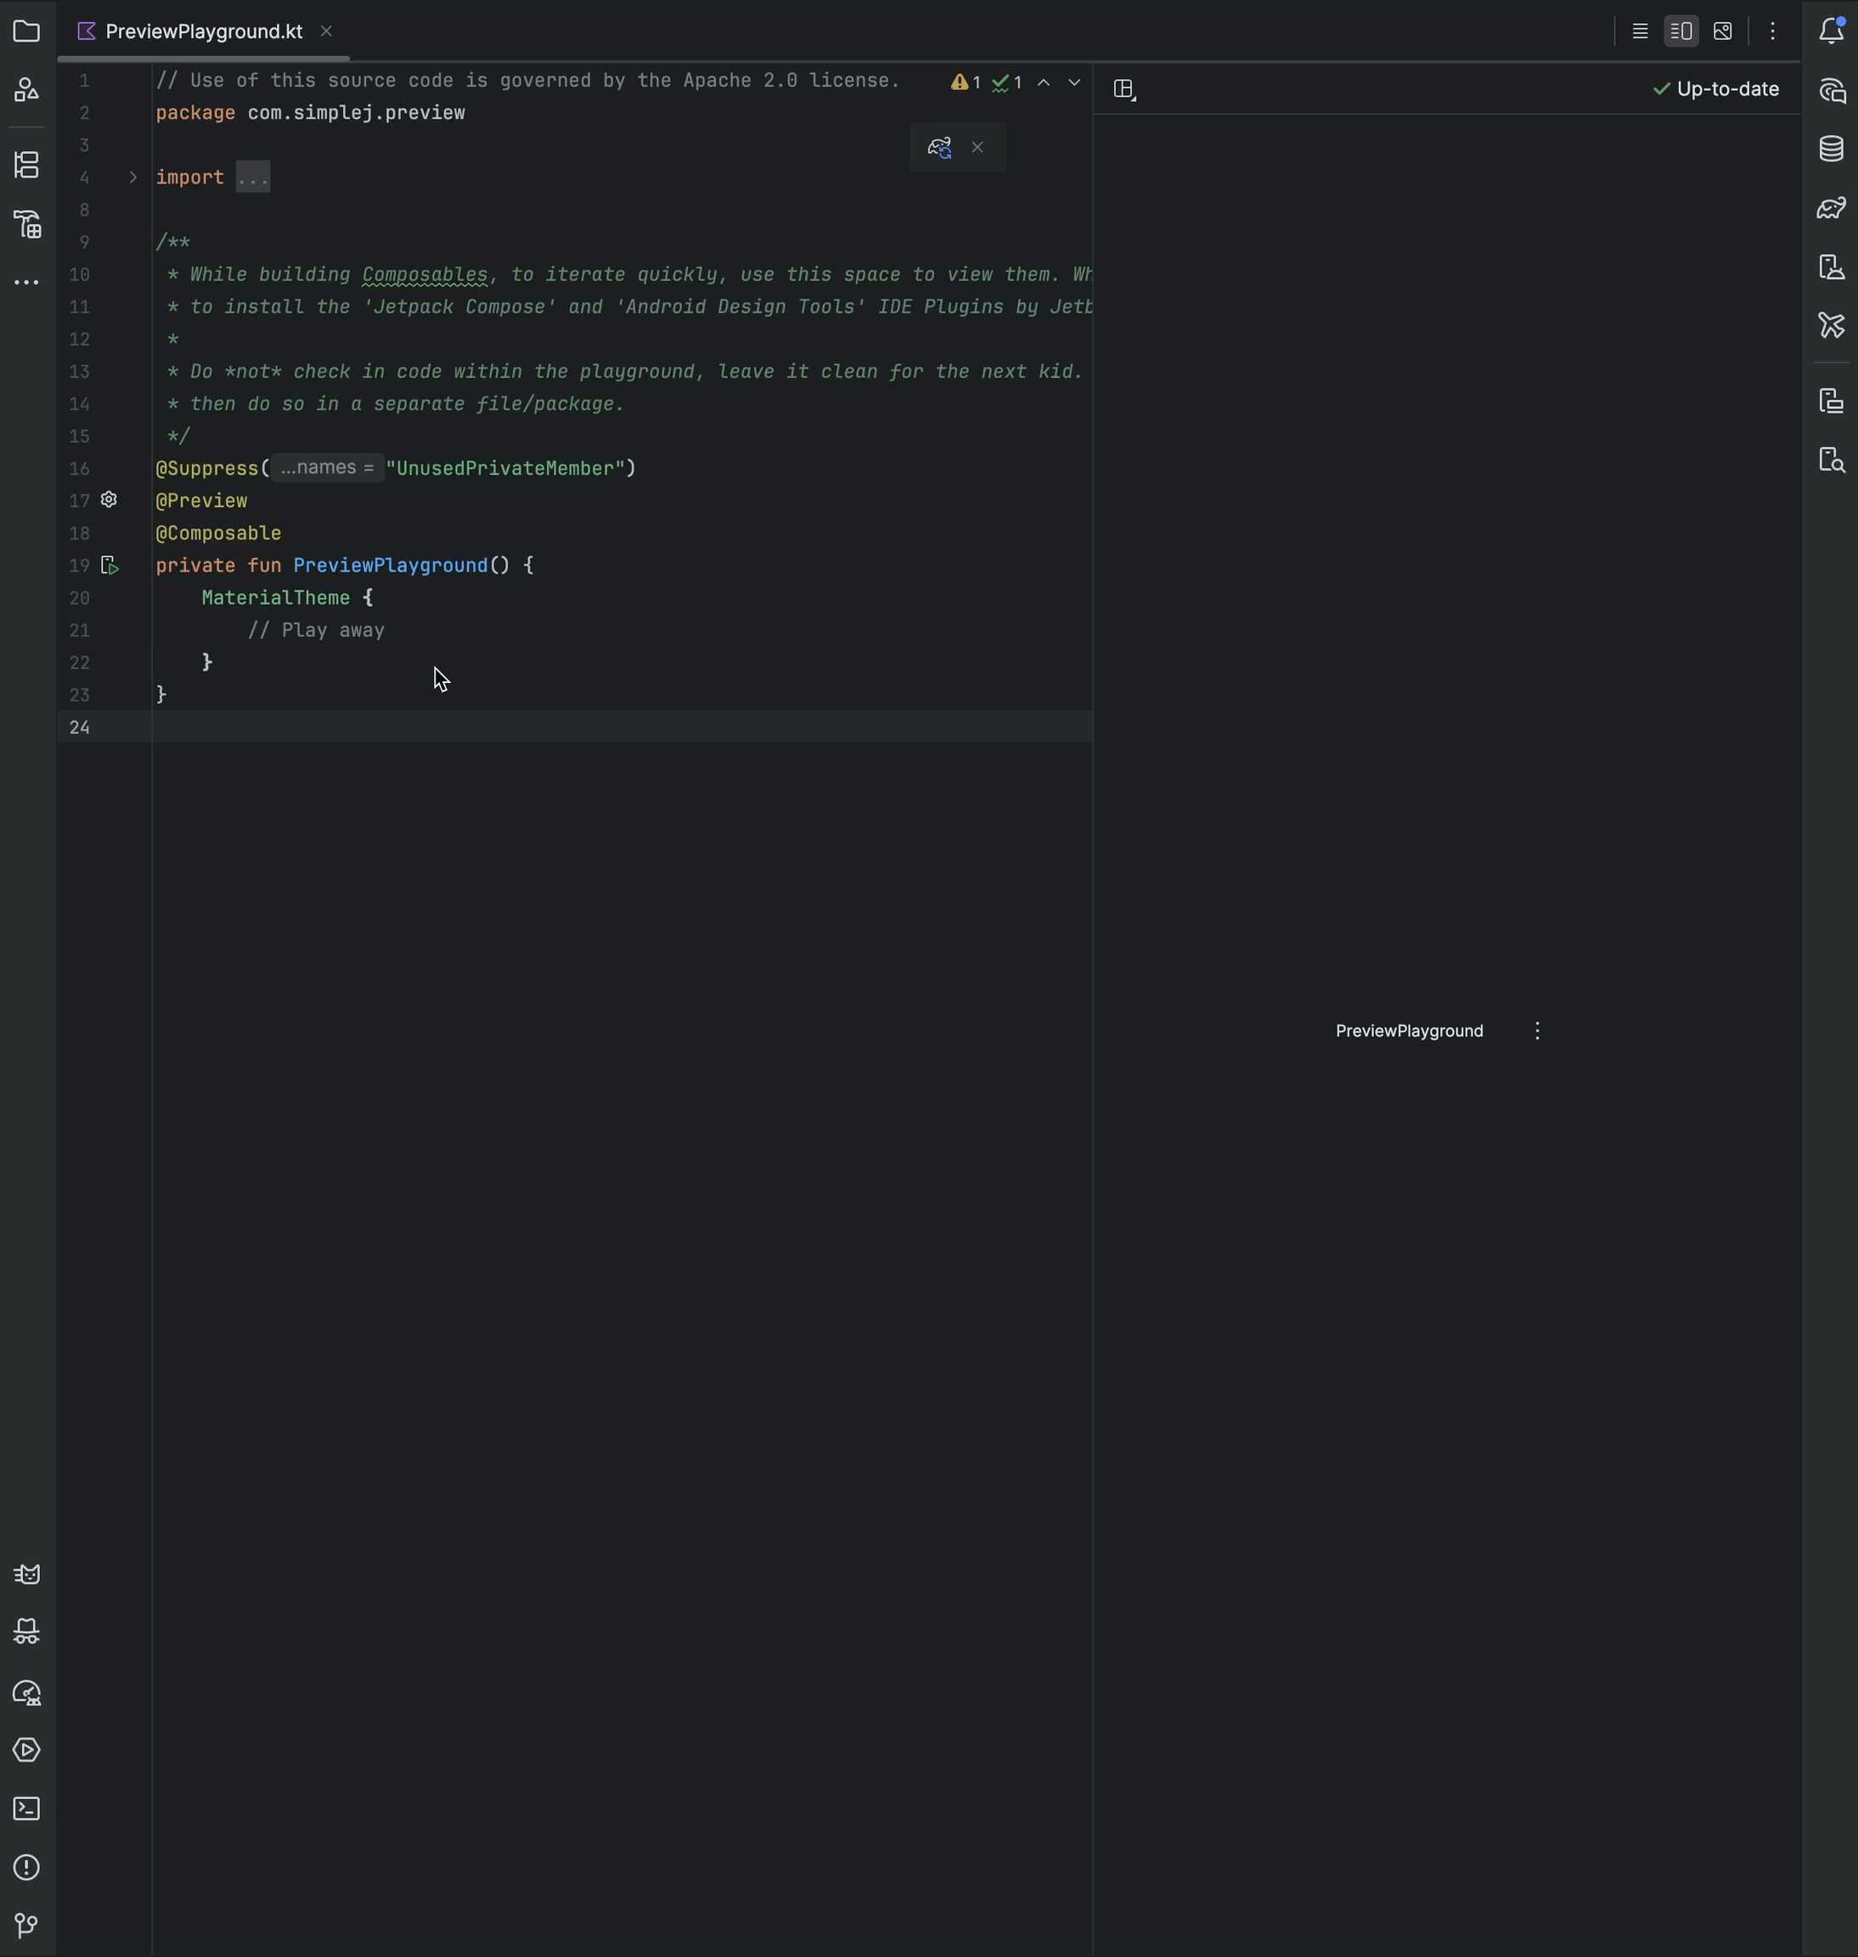
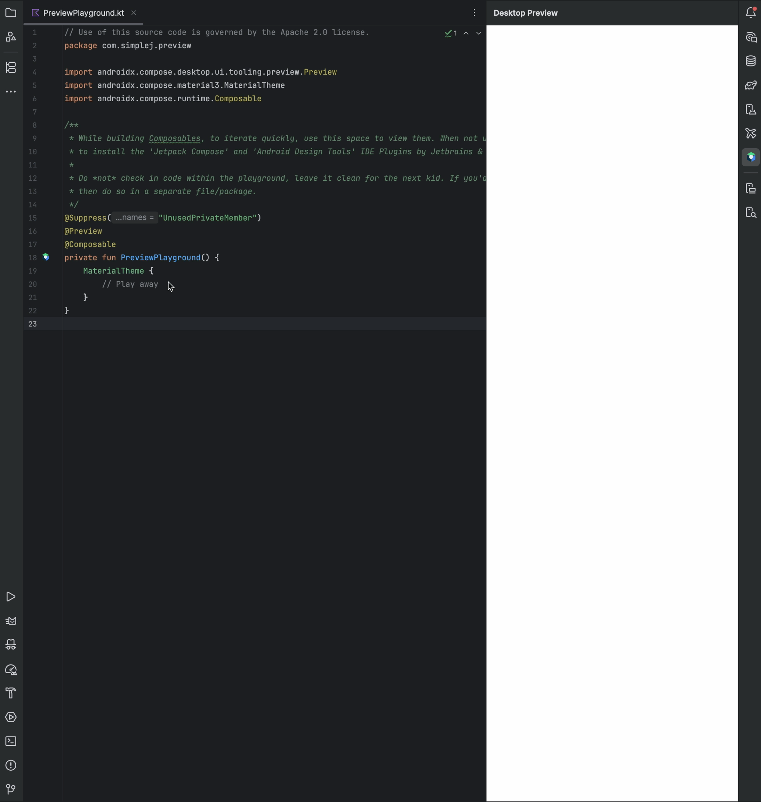
#ᴅʟᴘ_MICRODOT [{'title': 'Data Security Classification', 'text': 'Confidential'}, {'title': 'doc_id', 'text': '12JUmWeewr_0-FSgFp6q-ePuR78R652-tUpR5pDG63Us'}]_END
(Android’s) Automatic Preview
Kotlin Multiplatform
Notes:
On the left we see the automatic preview rendering in real time as code changes are made to the composable.
On the right we see the Kotlin Multi Platform IDE Plugin which requires tapping on the multiplatform gutter icon for re-rendering to occur. This takes your hands off of the keyboard.
While the gifs are likely out of sync by now when they first started you could see that our right panel had a head start but was still slower.

Slide 54
#ᴅʟᴘ_MICRODOT [{'title': 'Data Security Classification', 'text': 'Confidential'}, {'title': 'doc_id', 'text': '12JUmWeewr_0-FSgFp6q-ePuR78R652-tUpR5pDG63Us'}]_END
Some Additional IDEAs...
Being able to share machine information w/others
Automatic fixing of broken or misconfigured environment variables
Complimentary setup functionality
Pulling IDE click stream analytics
Creating a feedback mechanism for controllable IDE functionality
Notes:
Some additional ideas include…
Pulling machine information that could be shared with coworkers
Automatic fixing of broken or misconfigured environment variables
Complimentary setup functionality, such as downloading of specific packages (like build tools)
Pulling IDE Data analytics on engineering behaviors would be pretty helpful in understanding time spent doing certain tasks
There are other Plugins available for doing exactly that
Creating a feedback mechanism for engineers to use regarding certain actions, both from the Plugins you own and don’t

Slide 55
#ᴅʟᴘ_MICRODOT [{'title': 'Data Security Classification', 'text': 'Confidential'}, {'title': 'doc_id', 'text': '12JUmWeewr_0-FSgFp6q-ePuR78R652-tUpR5pDG63Us'}]_END
Thank you!
GitHub Link: https://github.com/wildsmith/simplej-plugin
Tom Belk
Notes:
Thank you all for coming to my talk today. As I mentioned previously SimpleJ is an open source project on github and available in the Plugin marketplace.
(At this point if there are time for questions I’ll open the floor).

